Slide 1
Lead User Guide: Application for Firm Certification
Updated 05/09/2022
Notes:
Welcome to the online tutorial for the Lead-Based Paint Program’s Application for Firm Certification. This tutorial will walk you through the process of completing and submitting an application for certification to EPA under the Renovation, Repair, and Painting (RRP) and/or Abatement programs.

Slide 2
Firm Public Site
https://www.epa.gov/lead/getcertified
Notes:
The Firm Certification application can be accessed through EPA’s Lead-Safe Certification Program public website, linked below. To enter the application, click the “Apply Now” logo or link on this webpage.
https://www.epa.gov/lead/getcertified

Slide 3
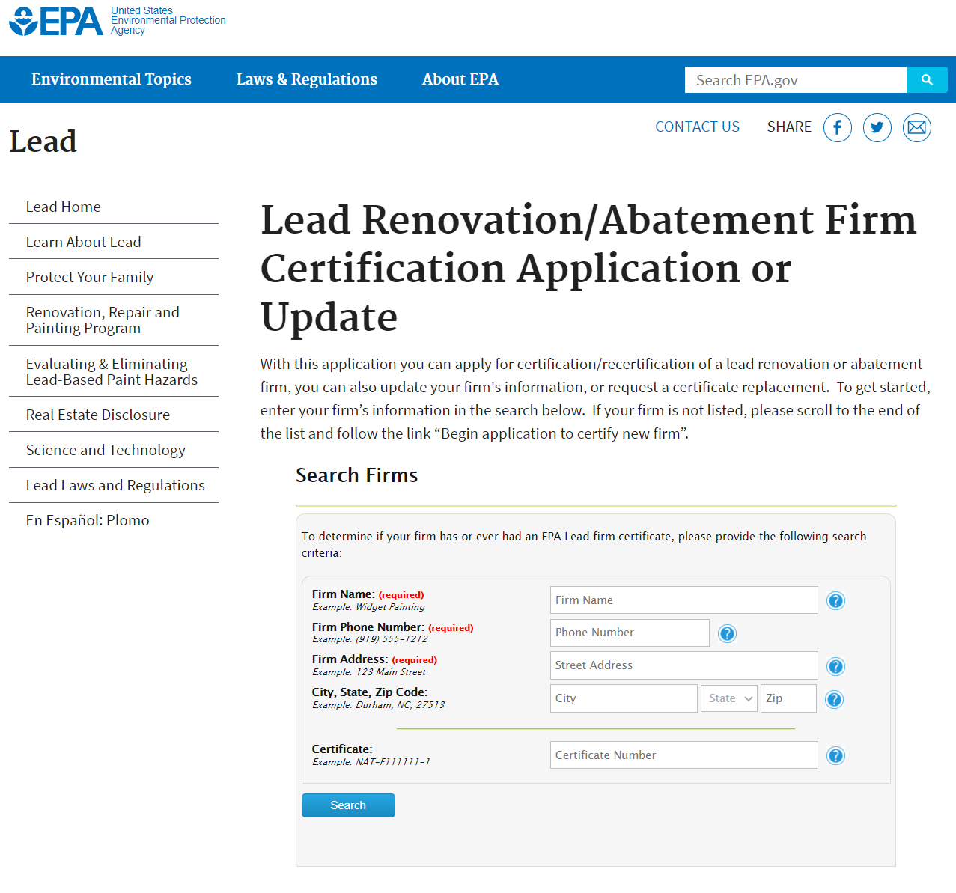
Firm Search
Notes:
All users seeking certification and/or updates for a firm must first search for an existing record. A business with an active certification can submit an application for recertification, an amendment to update their business information, or request a replacement copy of their certificate. A business seeking an initial certification has the option to begin a new application to certify their firm.
At a minimum, the user must enter their firm name, firm phone number, and firm address into the respective fields.

Slide 4
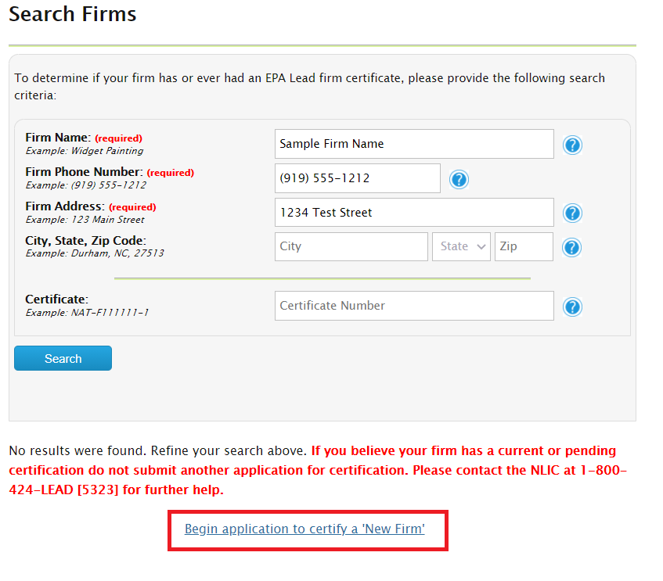
Firm Search – Certify a New Firm
Notes:
Firms that have never been certified will have the option to begin a new application by clicking the link highlighted above. Users will only be able to access this link after looking for their firm using the search tool.

Slide 5
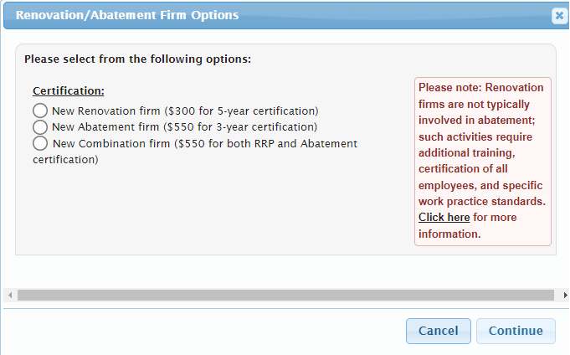
Firm Certification Options
EPA’s full refund policy can be found at
https://www.epa.gov/lead/epa-certification-program-fees-renovation-firms-and-abatement-firms.
Notes:
Clicking the link to begin the application to certify a new firm will open a pop-up window. In this window, the user can select to apply for certification as either a Renovation (RRP), Abatement firm, or apply for both certifications by selecting the Combination option.
Note: Once a firm is certified, the user will not be granted a refund. The user needs to make sure that they are applying for the appropriate certification. EPA’s full refund policy can be found at
https://www.epa.gov/lead/epa-certification-program-fees-renovation-firms-and-abatement-firms.

Slide 6
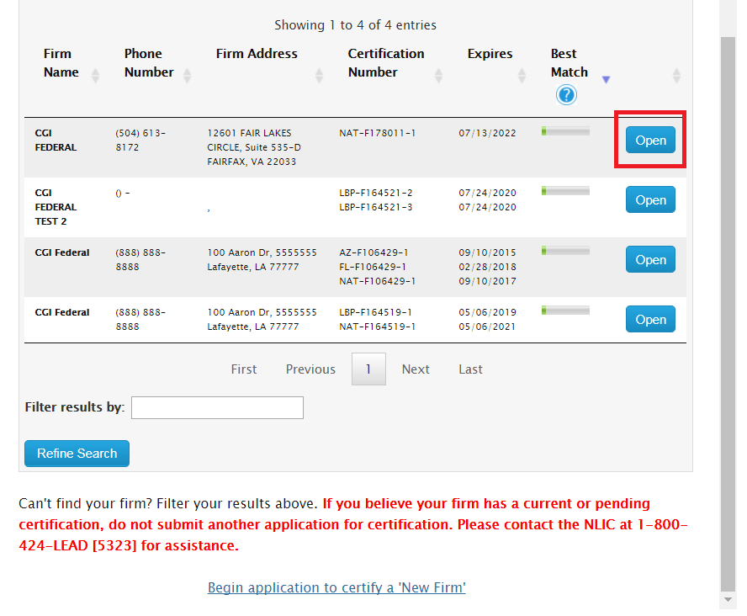
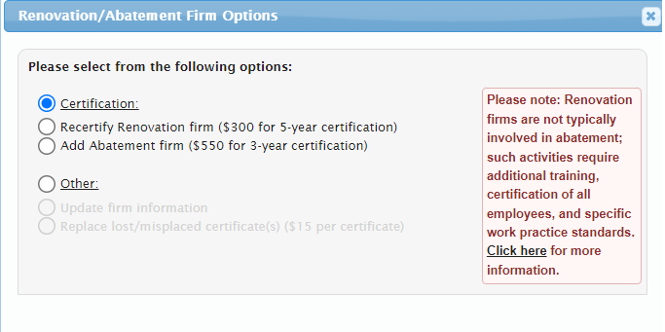
Firm Search Results
Notes:
Firms who find themselves on the search can click the “Open” button and do any of the following: apply for certification/recertification, update their firm’s information, or make a request for a certificate replacement.
Firms looking to recertify should select the “Certification” radio button. Their recertification options will depend on what certifications are currently active. In the example on this slide, the sample firm only holds a Renovation (RRP) certification, so the recertification option is only available for that certification type. This sample firm can choose to submit an application to get certified as an Abatement firm, but that will be considered an initial application. Firms that have both Renovation (RRP) and Abatement certifications are able to choose which/both certifications they need to recertify.

Slide 7
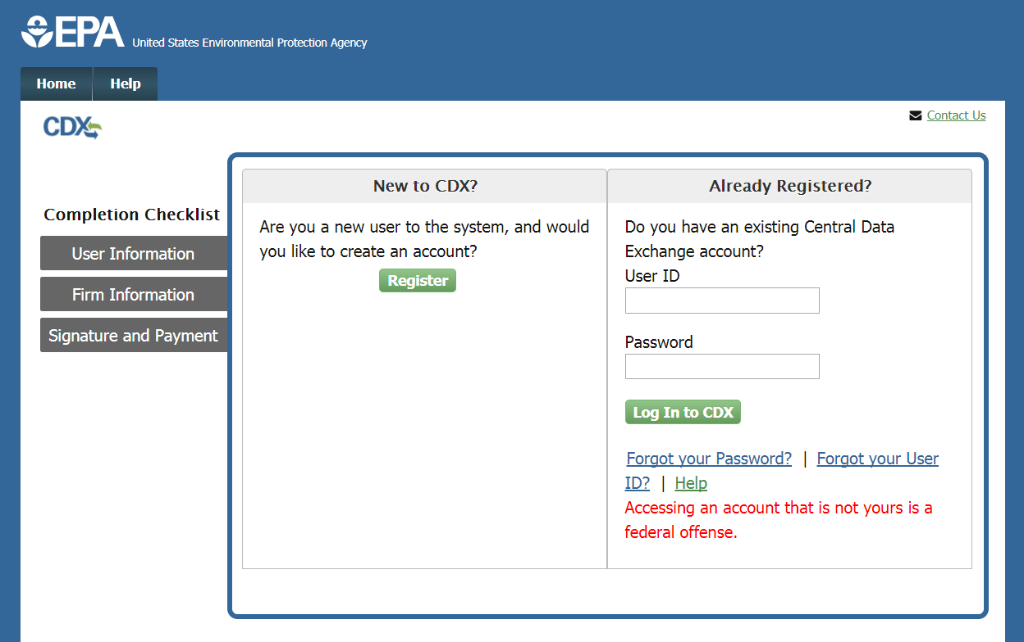
New Certification – CDX Register/Log In Page
Notes:
Once an application is selected, the user will be directed to the CDX Register/Log In page. If the user has previously used the Central Data Exchange (CDX) for reporting, they can enter their CDX user ID and password and click the “Log In to CDX” button. If the user has a CDX account but forgot their User ID or password, they can click the appropriate links and follow the steps provided to recover their information. If the user is new to CDX, they can click the “Register” button to create a new account.

Slide 8
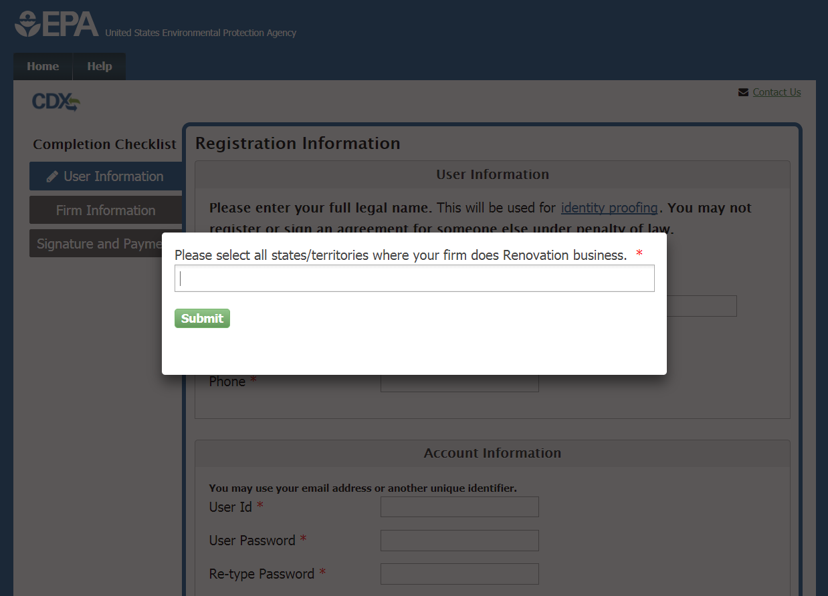
State/Territory Selection
To determine whether to apply to EPA and/or state, tribe or territory, refer to
https://www.epa.gov/lead/renovation-repair-and-painting-program-firm-certification#1 for Renovation (RRP), and/or
https://www.epa.gov/lead/lead-based-paint-abatement-and-evaluation-program-firm-certification#1 for Abatement.
Notes:
New and existing CDX users will first be prompted to select all states/territories where they plan to be doing Renovation and/or Abatement business. This helps the user determine whether they are obtaining the appropriate certification.
To determine whether to apply to EPA and/or state, tribe or territory, refer to
https://www.epa.gov/lead/renovation-repair-and-painting-program-firm-certification#1 for Renovation (RRP), and/or
https://www.epa.gov/lead/lead-based-paint-abatement-and-evaluation-program-firm-certification#1 for Abatement.

Slide 9
State/Territory Selection
Notes:
The user will see this message if the state(s)/territories selected are all covered by the EPA Lead program.

Slide 10
State/Territory Selection – EPA-Authorized States
Notes:
If a user enters a state that is authorized to issue its own certification, the user will be notified and linked to the state’s page.

Slide 11
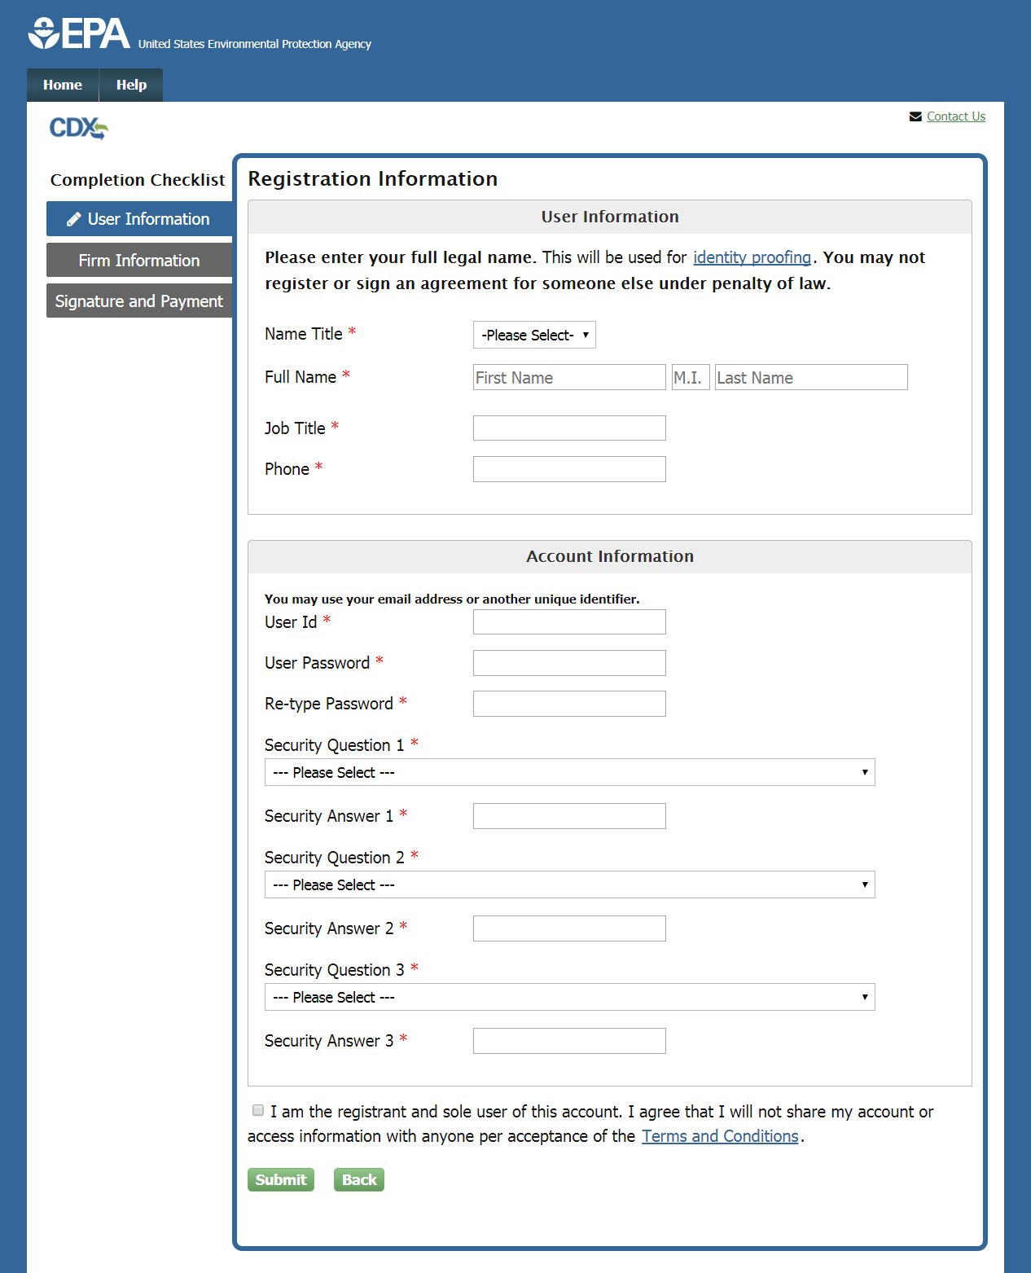
Registration Information Page – New CDX Account
Notes:
The first part of the application for new CDX users is the “User Information” page. The user must enter the appropriate information in all fields of this section.
The user must use their full legal name in the “Full Name” fields, as this information will be used for electronic identity proofing. For more information on the identity proofing process, click the “identity proofing” help link.
On this page, the user also creates their CDX user ID and password. This will be the information used to access CDX in the future, which includes access to submit Abatement Notifications for firms seeking abatement certification. The user may use their email address or any other unique name for their user ID; the user should NOT use their social security number as their user ID.
The user should also be careful to remember the password, as this will be used later to sign the application. Select three security questions and enter answers for each that are easy to remember but hard to guess.
Before continuing, click the link to open and carefully read the Terms and Conditions of the CDX system. Select the check box to agree to the Terms and Conditions before continuing by clicking the “Submit” button.

Slide 12
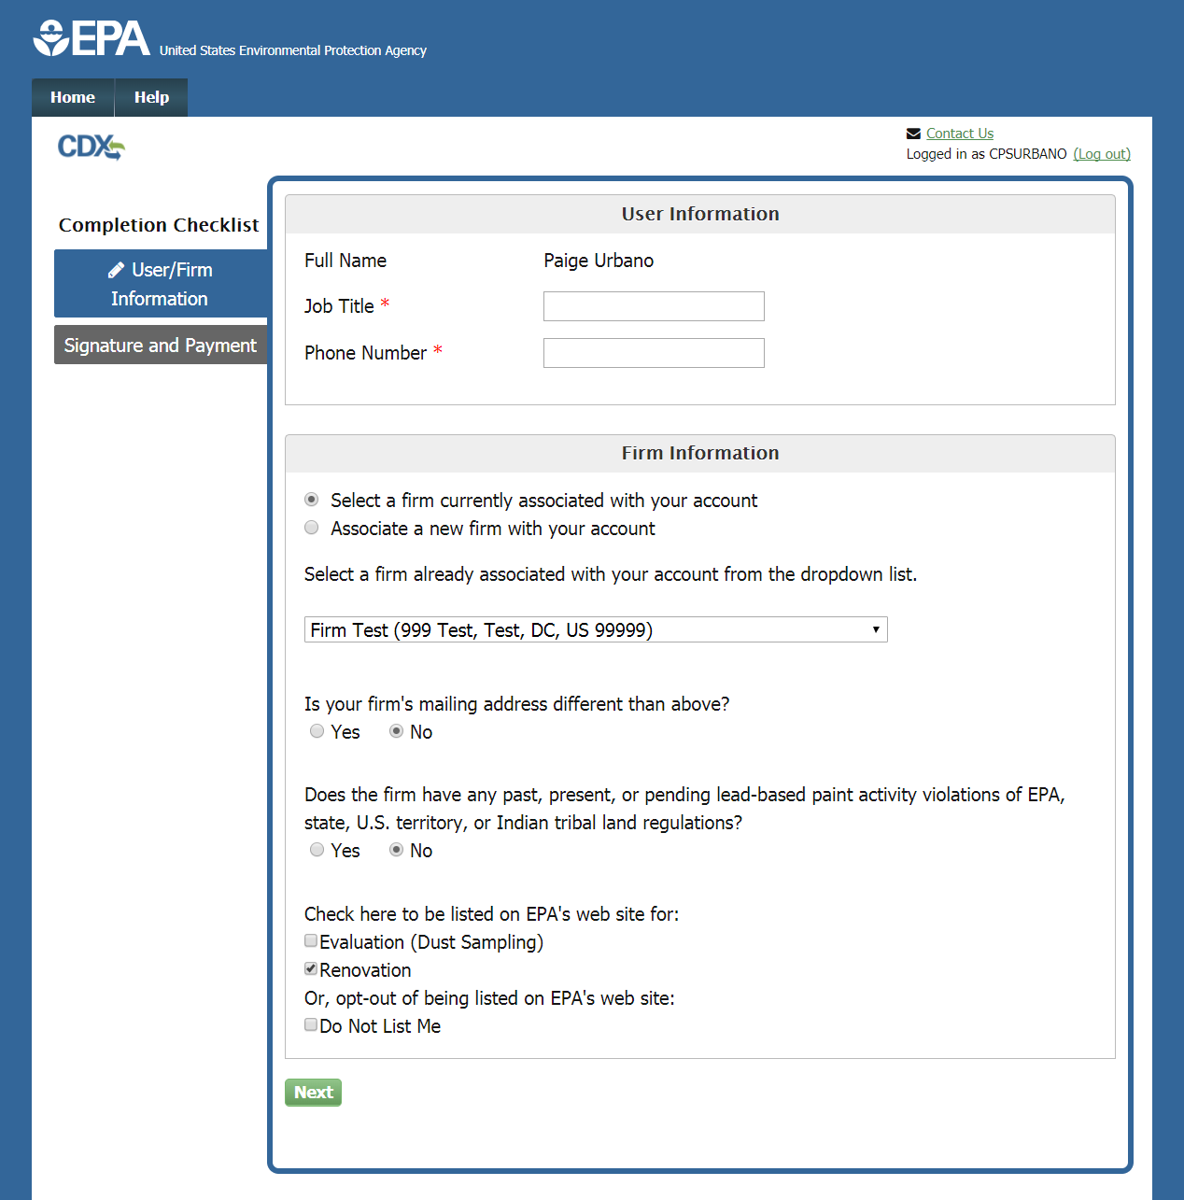
User/Firm Information Page – Existing CDX Account
Notes:
If the user has logged in as a previous CDX user, they will not have to complete the User Information page. They can simply enter their job title and phone number in the User Information section. Logged in users will also have the option to select a firm that is already associated with their CDX account by choosing from a dropdown menu. To add a new firm instead, select the “Associate a new firm with your account” radio button.

Slide 13
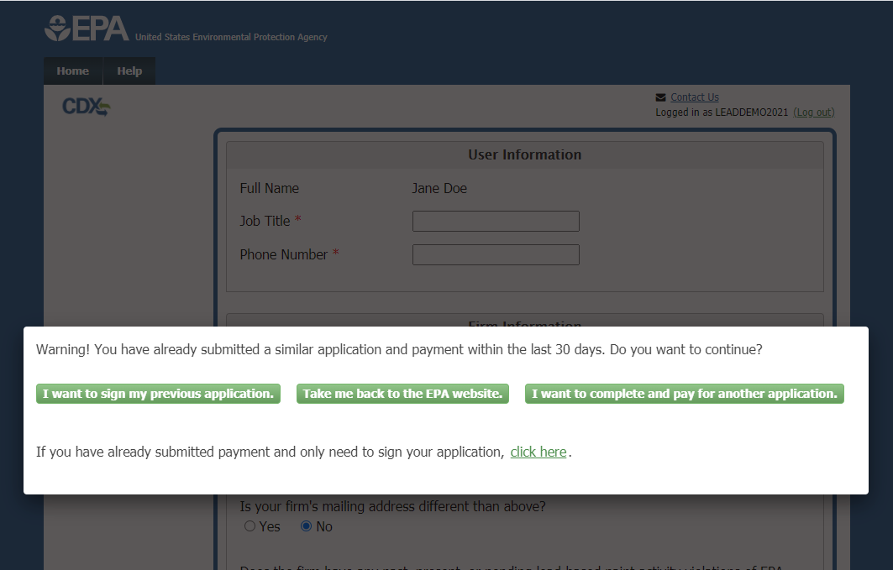
Recent Submission Warning
Notes:
If the user receives this message upon logging into CDX, it means they have submitted a Lead Firm Certification application within the last 30 days. If this is correct and no further action is needed, click the “Take me back to the EPA website” button to exit the application. If the user believes their previous submission is complete but has not been signed, they can click “I want to sign my previous application” to re-enter the application process where they left off.
In some cases, a user may wish to submit and pay for multiple applications. For example, they may be applying for certification for two branches of a business that require separate certifications. If this applies, click “I want to complete and pay for another application” to begin a new electronic application. Note that selecting this option will require the user to pay the full fee for the new application.

Slide 14
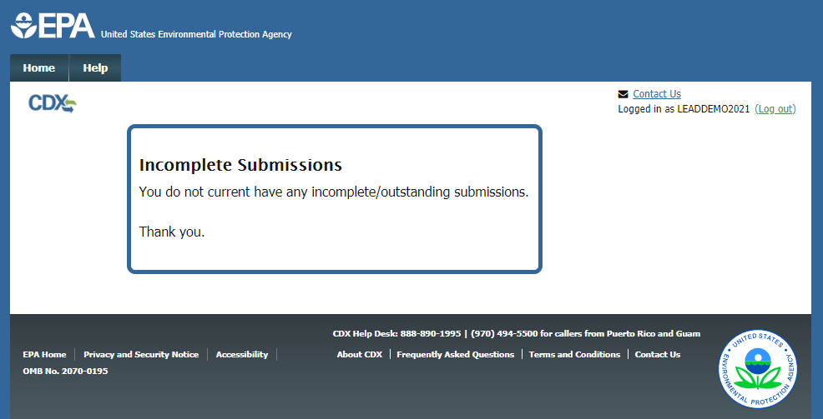
Incomplete Submissions
Notes:
Clicking “I want to sign my previous application” on the prior screen will take the user back into the system to sign any outstanding submissions. In most cases a user will see this page, indicating there are no outstanding submissions. If this is the case, their previous submission was successfully signed and no further action is required.

Slide 15
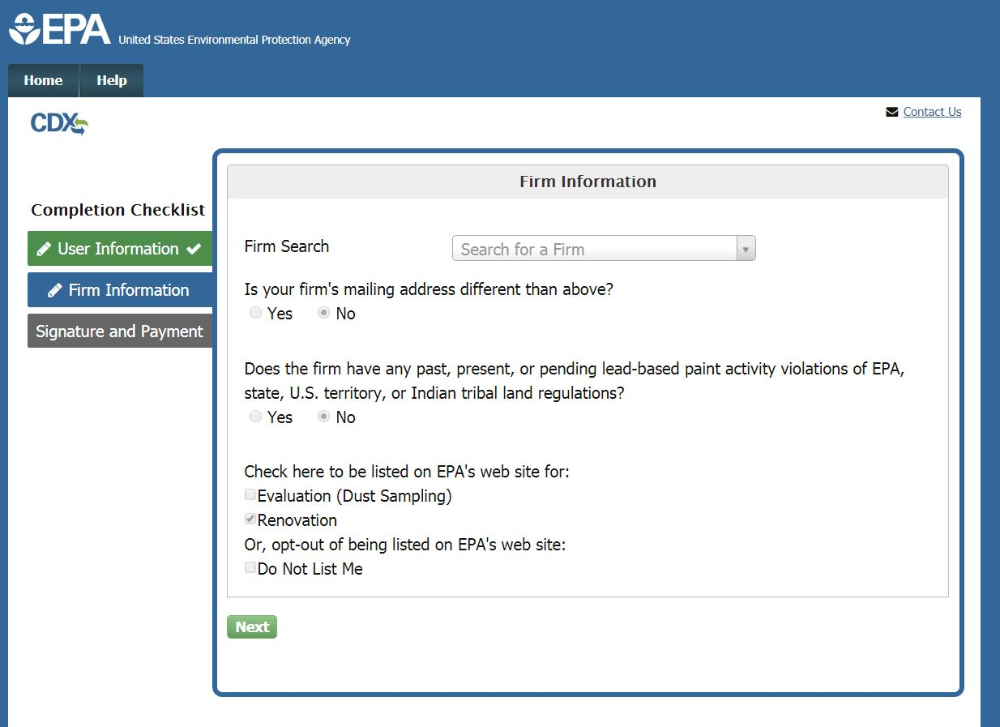
Firm Information Page
Notes:
Upon entering User Information as a new CDX user, the user will be taken to the Firm Information page. The user can search for their firm by entering the firm name in the Firm Search box. Results will begin displaying upon entering at least three characters.

Slide 16
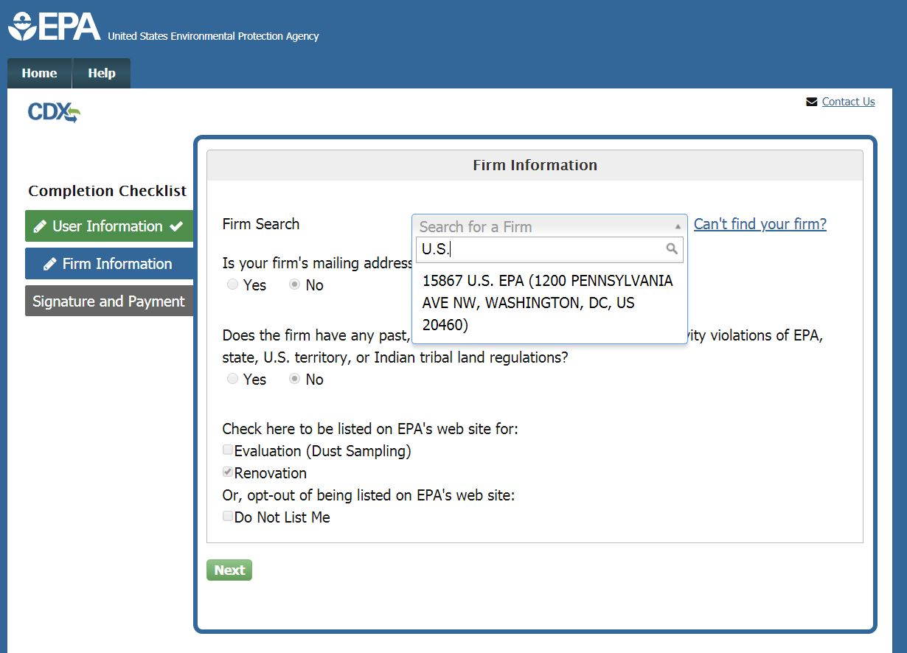
Firm Search
Notes:
If the user’s firm is listed in the search results, select it from the list and verify that the firm name and address displayed is correct. There may be multiple firms with similar names, so it is important to verify both the name and address associated. If the user’s firm is not listed, they can click “Can’t Find your Firm?” to create a new firm in the system. The “Use advanced search” option is also available to search by other specific criteria. If the user is completing a Recertification application as a returning CDX user, the Firm Information section will be pre-populated.

Slide 17
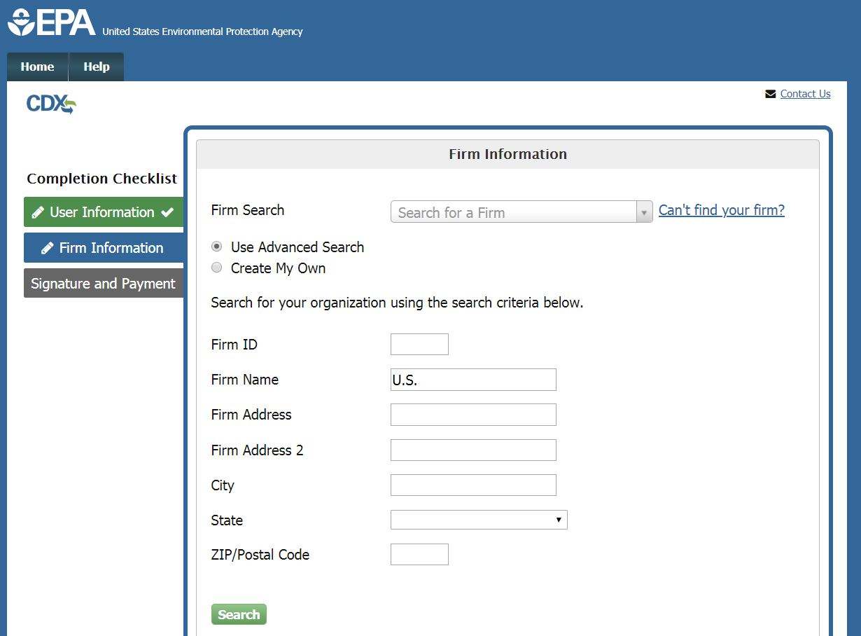
Firm Advanced Search
Notes:
Selecting the Advanced Search option will allow the user to search for the firm by a variety of search criteria including: Firm ID, Firm Name, and Firm Address. Enter at least one of these criteria and click “Search” to search for the firm.

Slide 18
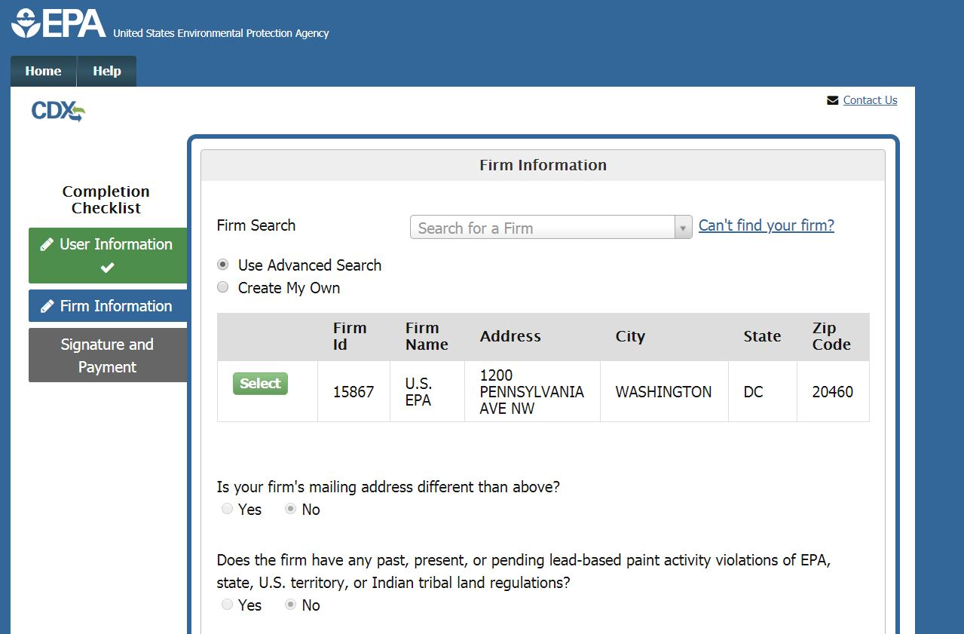
Advanced Search Results
Notes:
The results of the advanced search will be displayed in a table. If the firm is displayed in the list, click the “Select” button to the left of the appropriate firm. If it is not, select the “Create My Own” radio button to manually enter the firm’s information.

Slide 19
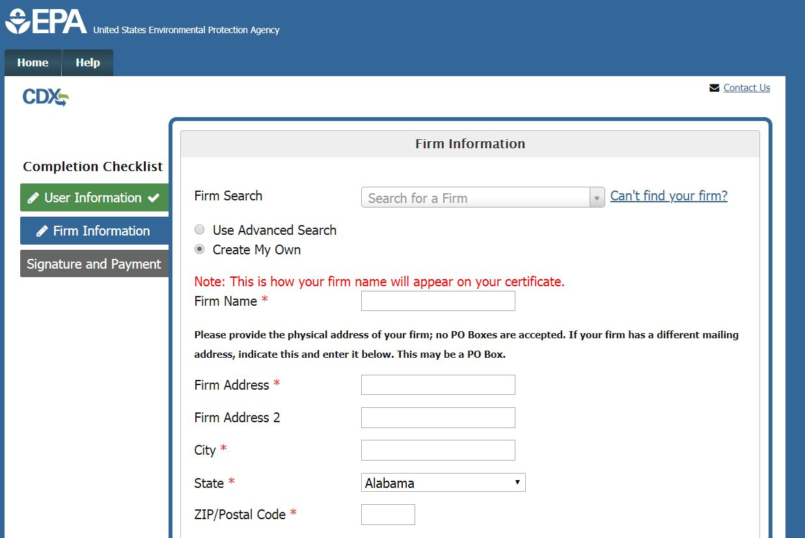
‘Create My Own’ Firm Option
Notes:
To request to add a new firm to the database, enter the required information in this form.
Please note that PO Boxes for the business address are not acceptable. The user can specify a PO Box for their mailing address later in the form, if necessary.

Slide 20
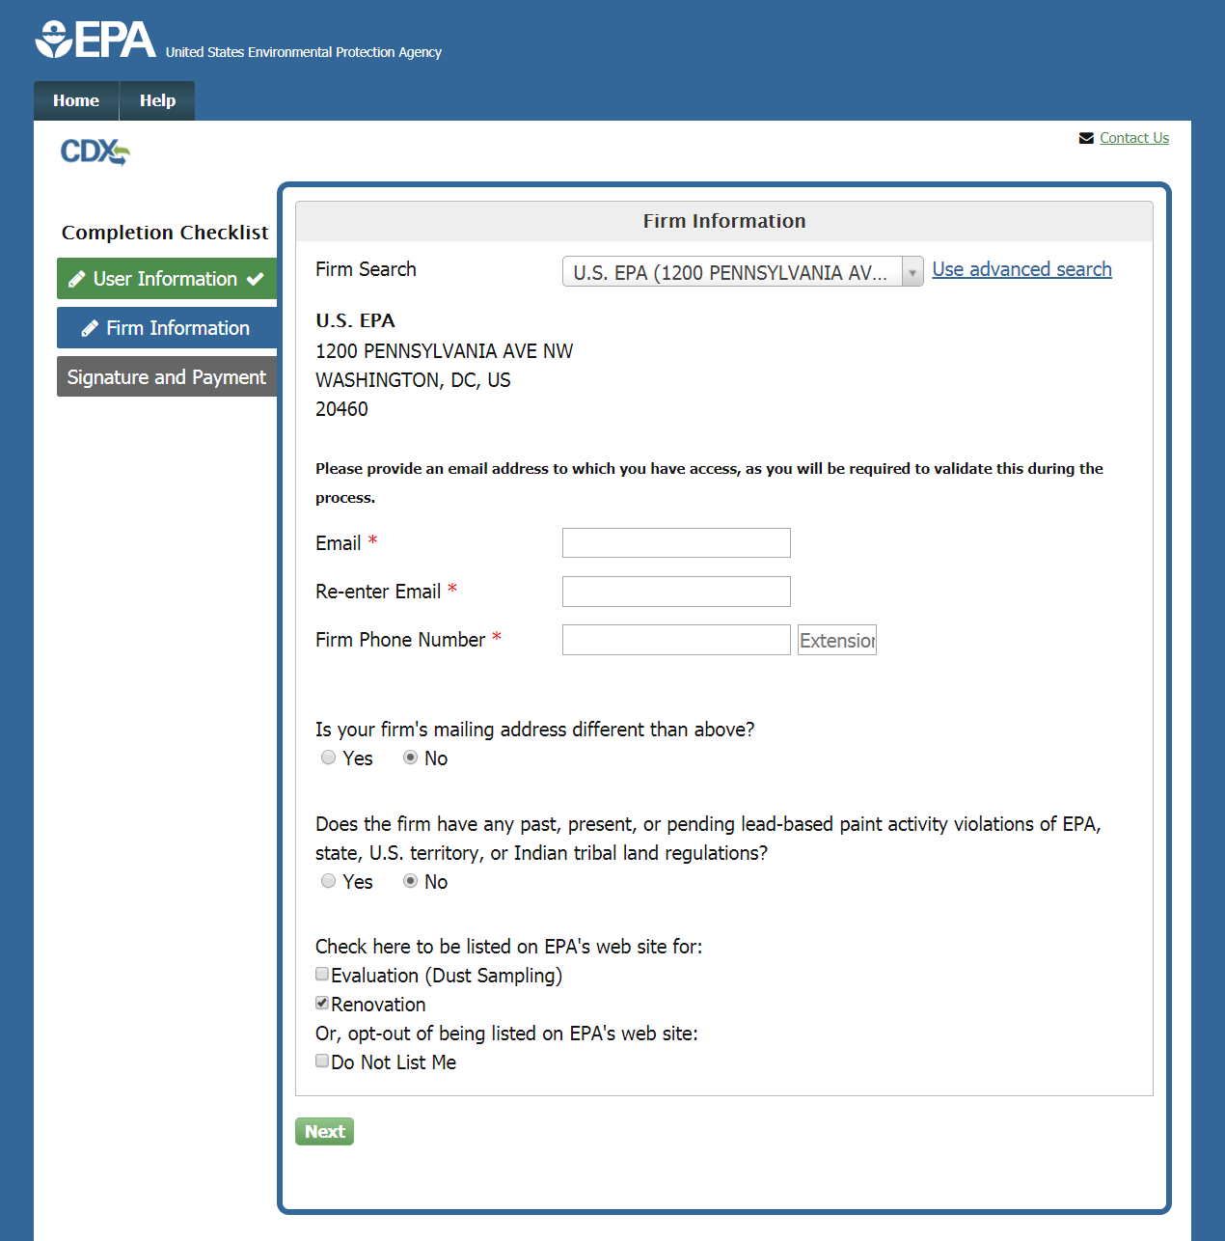
Firm Information
Notes:
Once the firm has been selected from the list, verify that its name and address are displayed correctly. Then enter an email address and provide the Firm’s Phone Number and extension, if applicable.

Slide 21
Firm Information, Violation History, Listing Preference
Notes:
If the firm has a mailing address that is different from the physical address listed, select the “Yes” button to enable the Mailing Address fields and enter the appropriate information.
Indicate whether the firm does or does not have any past, present, or pending lead-based paint activity violations of EPA, state, U.S. territory, or Indian tribal land regulations by selecting either the “Yes" or “No” radio button. If “Yes” is selected, a text box will appear for the user to provide a required explanation.
At the bottom of the page, the user can choose whether they want the firm to be listed on the EPA website for Renovation, Lead Abatement (if applicable), and/or Evaluation. The user may select one or more of these options or select “Do not list me” to opt out.
Click “Next” once the page is complete to continue the application.

Slide 22
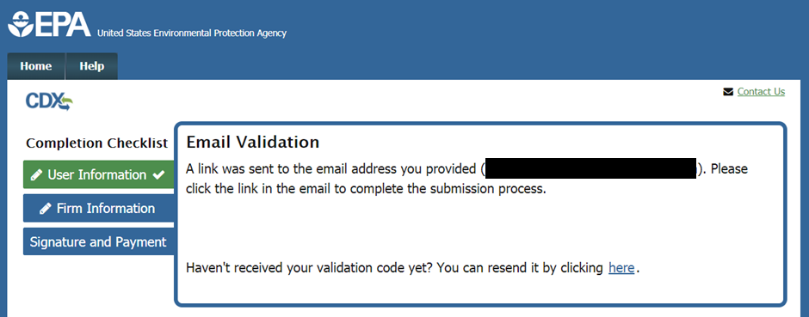
Email Validation
Notes:
Once the form is completed, an email will be sent to the email address provided containing a validation URL.

Slide 23
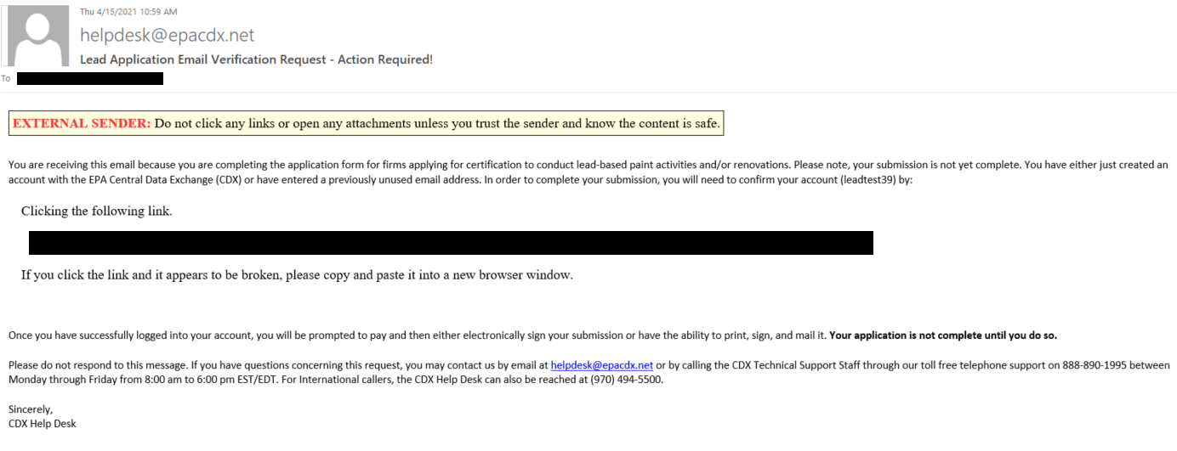
Email Verification
Notes:
Above is a redacted example of the email message for Email Verification. Click the link to validate the email and resume the application.

Slide 24
Review and Payment Page
Notes:
On the Signature and Payment page, verify that the information displayed in read-only format is correct and complete. If any changes are required, click the “Edit” button next to the appropriate section of the page.

Slide 25
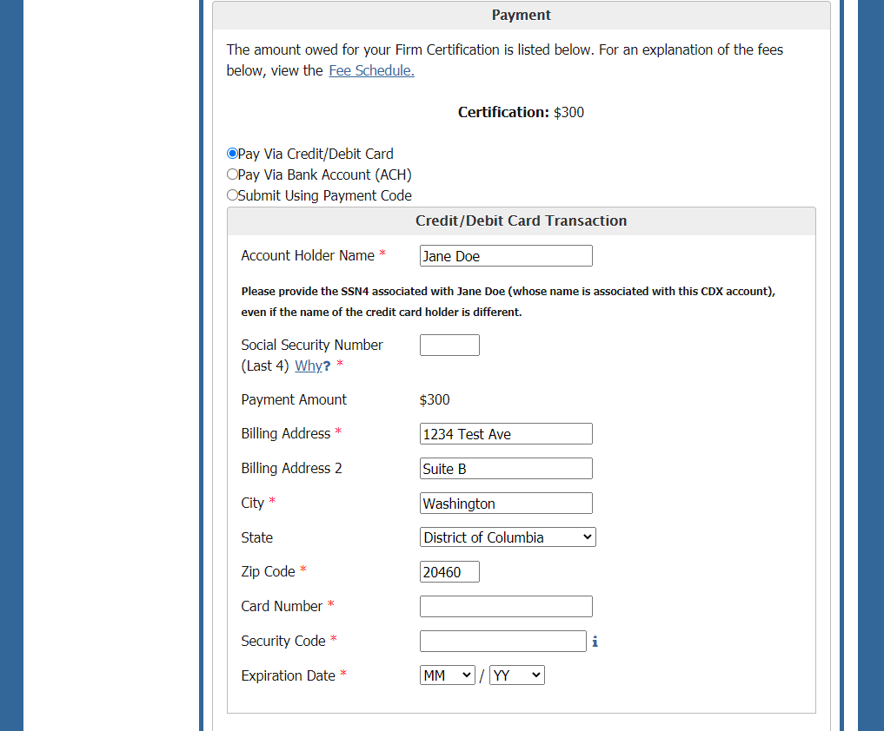
Paying with Credit Card
Notes:
The total cost for certification is displayed in the Payment section. The user may select to pay this amount either by credit or debit card, with a bank account ACH transfer, or with a payment code. Select the appropriate method by clicking the appropriate radio button. To pay by credit or debit card, enter the card number, security code, and expiration date of the card. If the name or address of the cardholder is different from what is displayed, edit those fields.
As a new CDX user, for identity proofing purposes, enter the last four digits associated to the name of the CDX user’s social security number in the corresponding field. Please provide the social security number of the person whose name is associated with the CDX account, and not the cardholder, if the two are different. The name associated with the CDX account is displayed above the SSN field.
The credit card expiration fields are defaulted to the current month and year. The month drop down does not display the months of the year that have passed unless the year option is changed. If the user is having trouble finding the desired month in the month dropdown, first change the year in the year dropdown, then select the desired month.

Slide 26
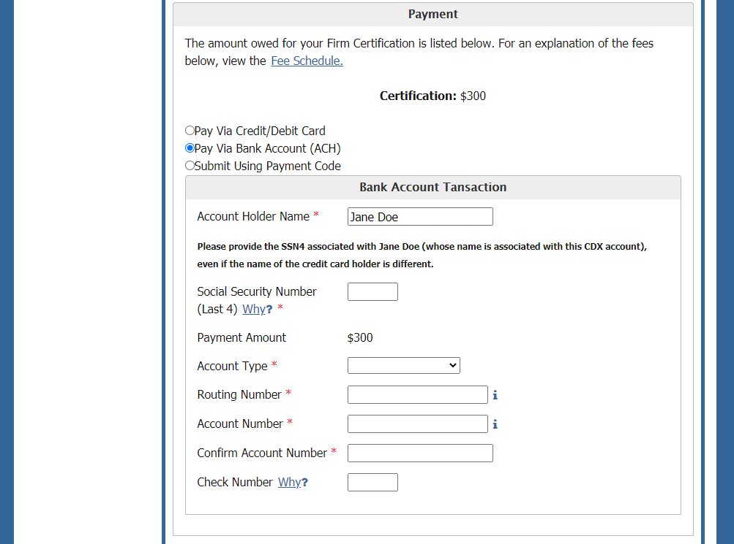
Paying with a Bank Account Transfer (ACH)
Notes:
To pay with a bank account transfer, select the account type and enter the routing number and account number.
As in the case of credit or debit card payments, the last 4 digits of the social security number must be entered. Please provide the social security number of the individual whose name is associated with the CDX account rather than the bank account holder, if the two are different. When the above information is completed, click the “Complete payment” button to submit and pay for the application.

Slide 27
Paying with a Payment Code
Notes:
To pay with a payment code, enter the payment code in the appropriate field.
For the identity proofing portion, enter the social security number (last 4), date of birth, and home address. Be sure to enter the identity proofing information for the person whose name is associated with the CDX account, seen in this section as Account Holder Name.

Slide 28
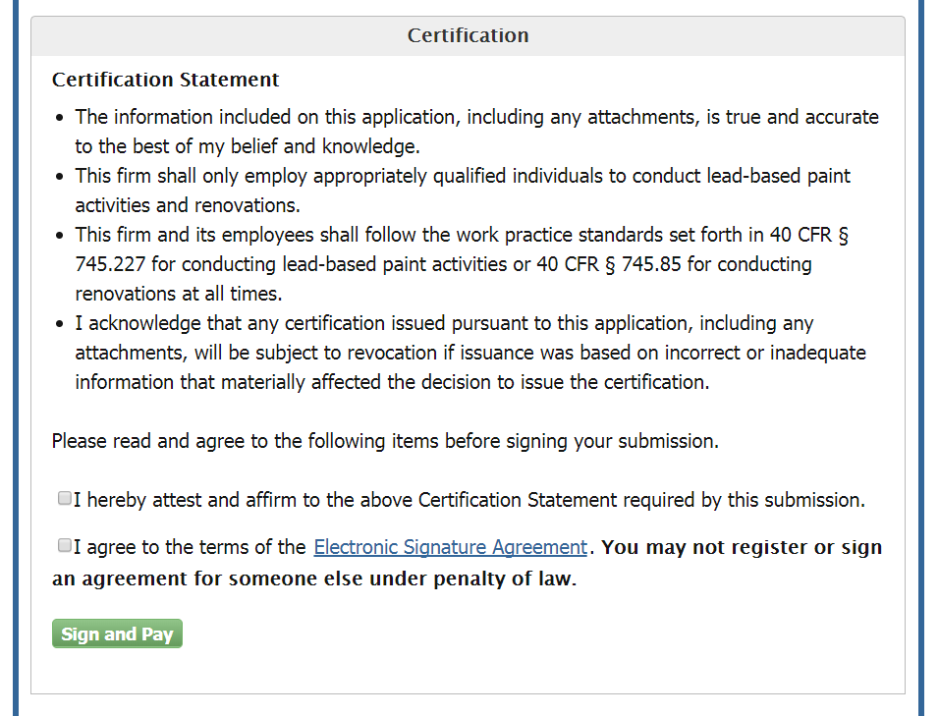
Certification Statement
Notes:
The last section on the Review and Payment page is the Certification section. Read the full text of the Certification Statement as displayed, and affirm acceptance of the terms. Clicking the link to the Electronic Signature Agreement will display the full text of the document. To sign, the user must check both of the boxes to affirm both statements.

Slide 29
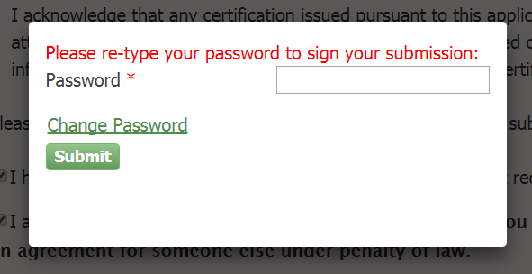
Signature Request
Notes:
Once the user has checked both of the boxes and completed all application fields, clicking “Sign and Pay” will open a pop-up window. Enter the CDX account password to continue.

Slide 30
Processing Request
Notes:
The process for submitting the application and processing payment may take a few minutes. It is important that the user does not close the window while the system is processing, to avoid duplicate charges.

Slide 31
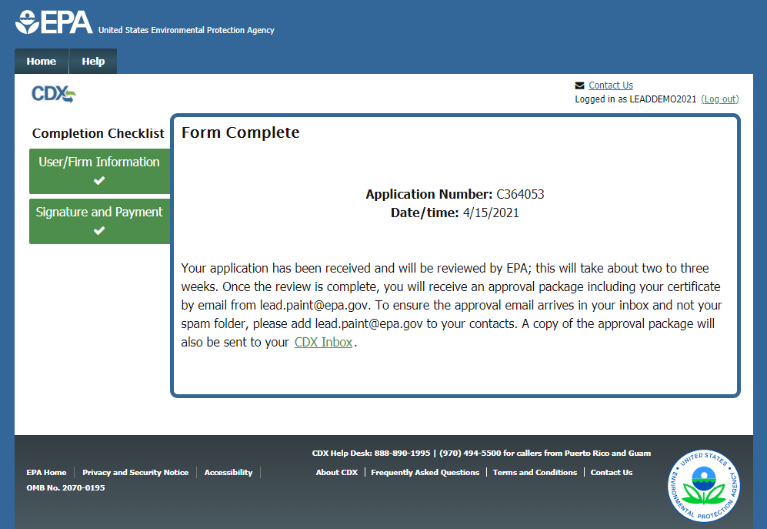
Submission Confirmation
Notes:
Once the application is complete and signed, the process is complete. If the user passed the electronic Identity Proofing step, their password is considered their legal signature and the application is complete. On this page, the user will see their application number and the submission date. The application will now be reviewed by EPA. Once the review is complete, the applicant will receive a confirmation email from lead.paint@epa.gov with further details.

Slide 32
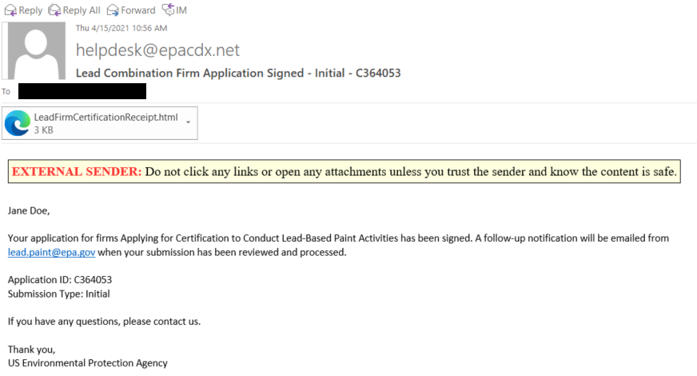
Confirmation Email
Notes:
If the application is complete and signed, the user will receive an email similar to the above for confirmation.

Slide 33
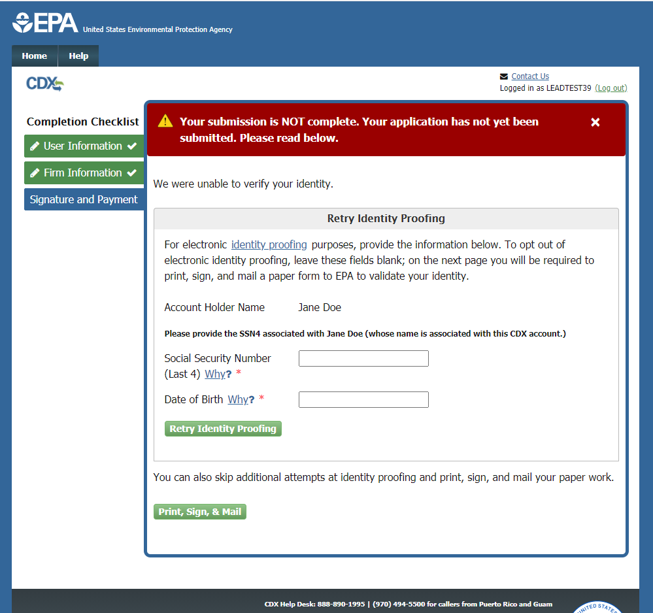
Identity Proofing Retry
Notes:
If the user does not pass the electronic identity proofing process they can retry on this page, or choose to print, sign, and mail the paper form of the Electronic Signature Agreement (ESA) and Submission Certification Statement to EPA. The user has up to three attempts for identity proofing.
Note that the electronic application has been submitted but not signed; if the user is unable to pass identity proofing, it will be considered signed upon receipt of the paper ESA with a wet ink signature. The mailing address to send the paperwork to is displayed at the bottom of the document.

Slide 34
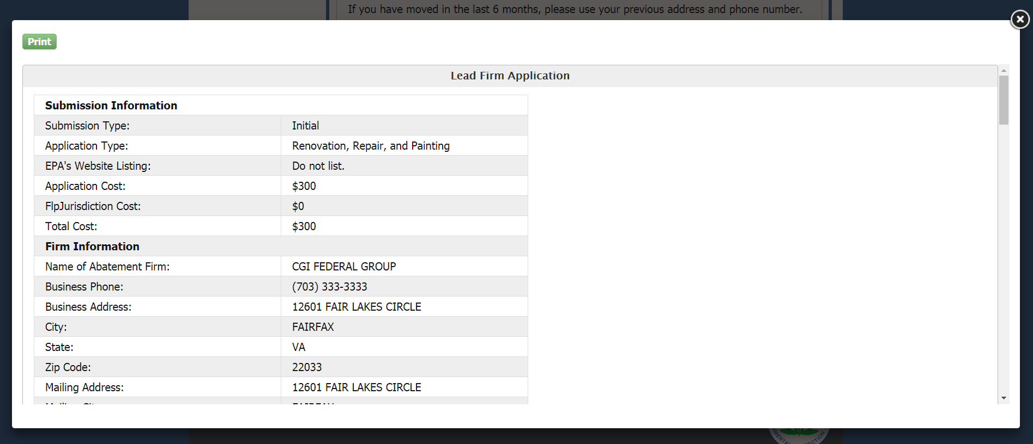
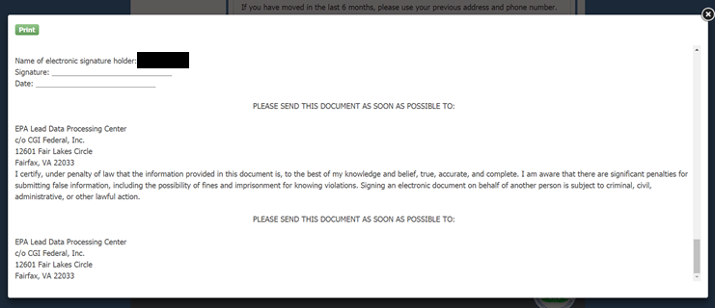
Electronic Signature Agreement (ESA)
Notes:
Click the “Print, Sign, & Mail” button to generate the Electronic Signature Agreement. The user must print, sign, and mail this page to the address listed at the bottom of the document.

Slide 35
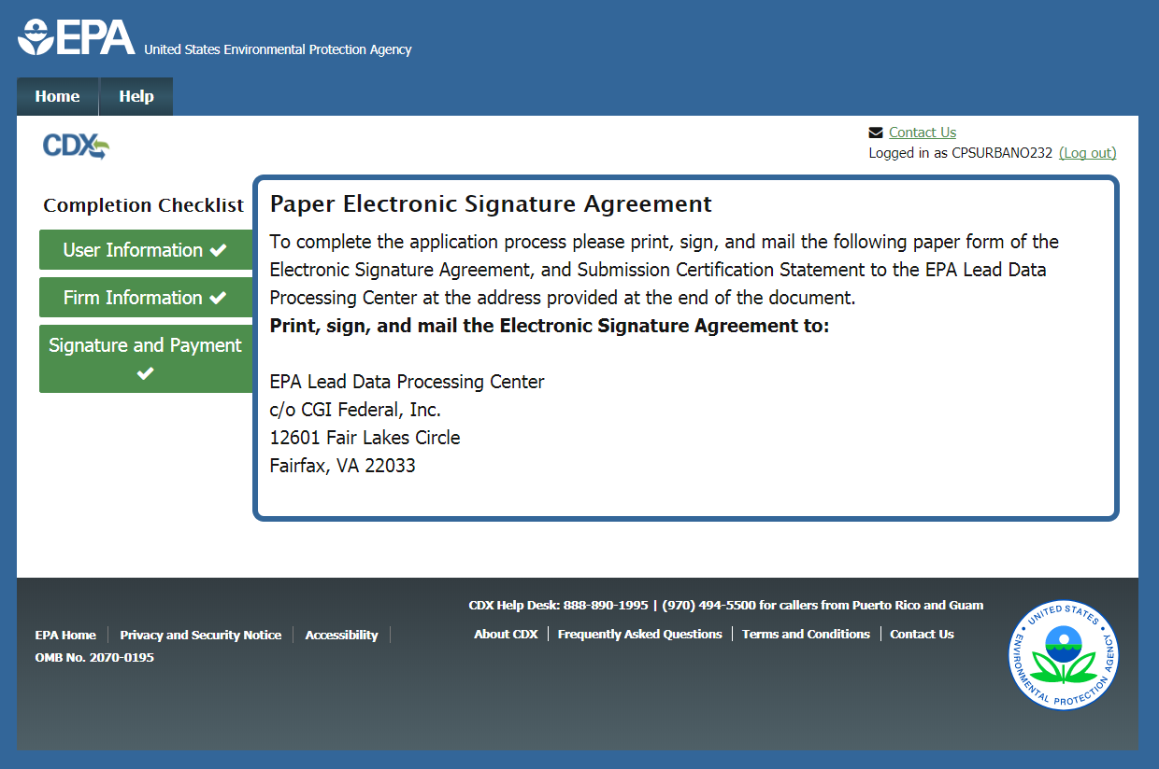
Electronic Signature Agreement (ESA)
Notes:
Once the document is printed, the address is displayed on the screen as well.

Slide 36
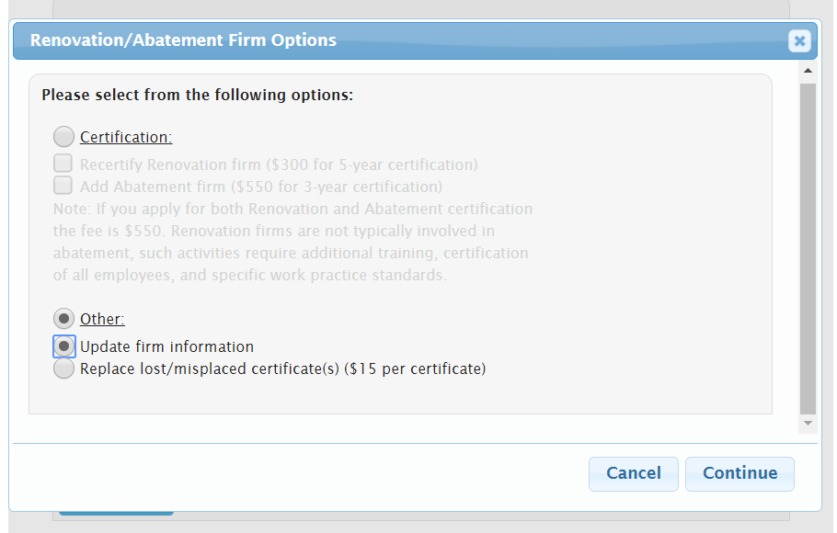
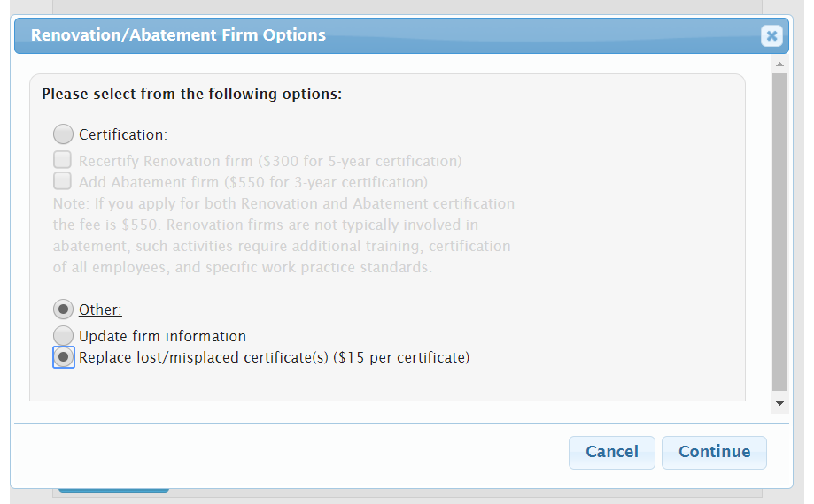
Options to Update Firm Information or Replace a Certificate
Notes:
Firms looking to update their information or request a replacement copy of their certificate should select the “Other” option in the pop-up window.
The “Update firm information” option will create an Information-Only Amendment application, where the user can update the information for an existing certification.
The “Replace lost/misplaced certificate(s)” option will open an application to request a copy of the certificate. Each replacement certificate request is $15. If the certificate in question was issued after December 1, 2020, the user should try checking if the approval package is already in their CDX Inbox before submitting a replacement request and remitting a fee.

Slide 37
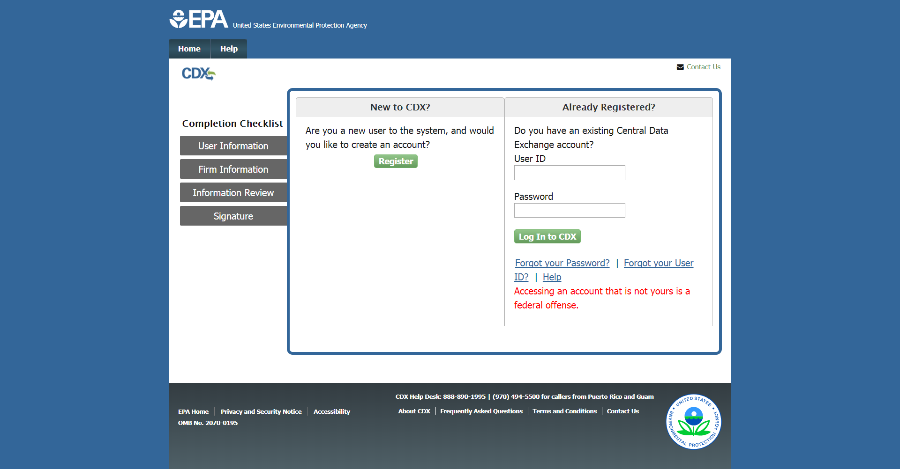
Information-Only Amendment – CDX Log In Page
Notes:
Firms seeking to update their information will be redirected to the Central Data Exchange (CDX) log in page.
If the user has previously used CDX, they can enter their CDX user ID and password and click the “Log In to CDX” button. If the user has a CDX account but forgot their User ID or password, they can click the appropriate links and follow the steps provided to recover their information. If the user is new to CDX, they can click the “Register” button to create a new account.

Slide 38
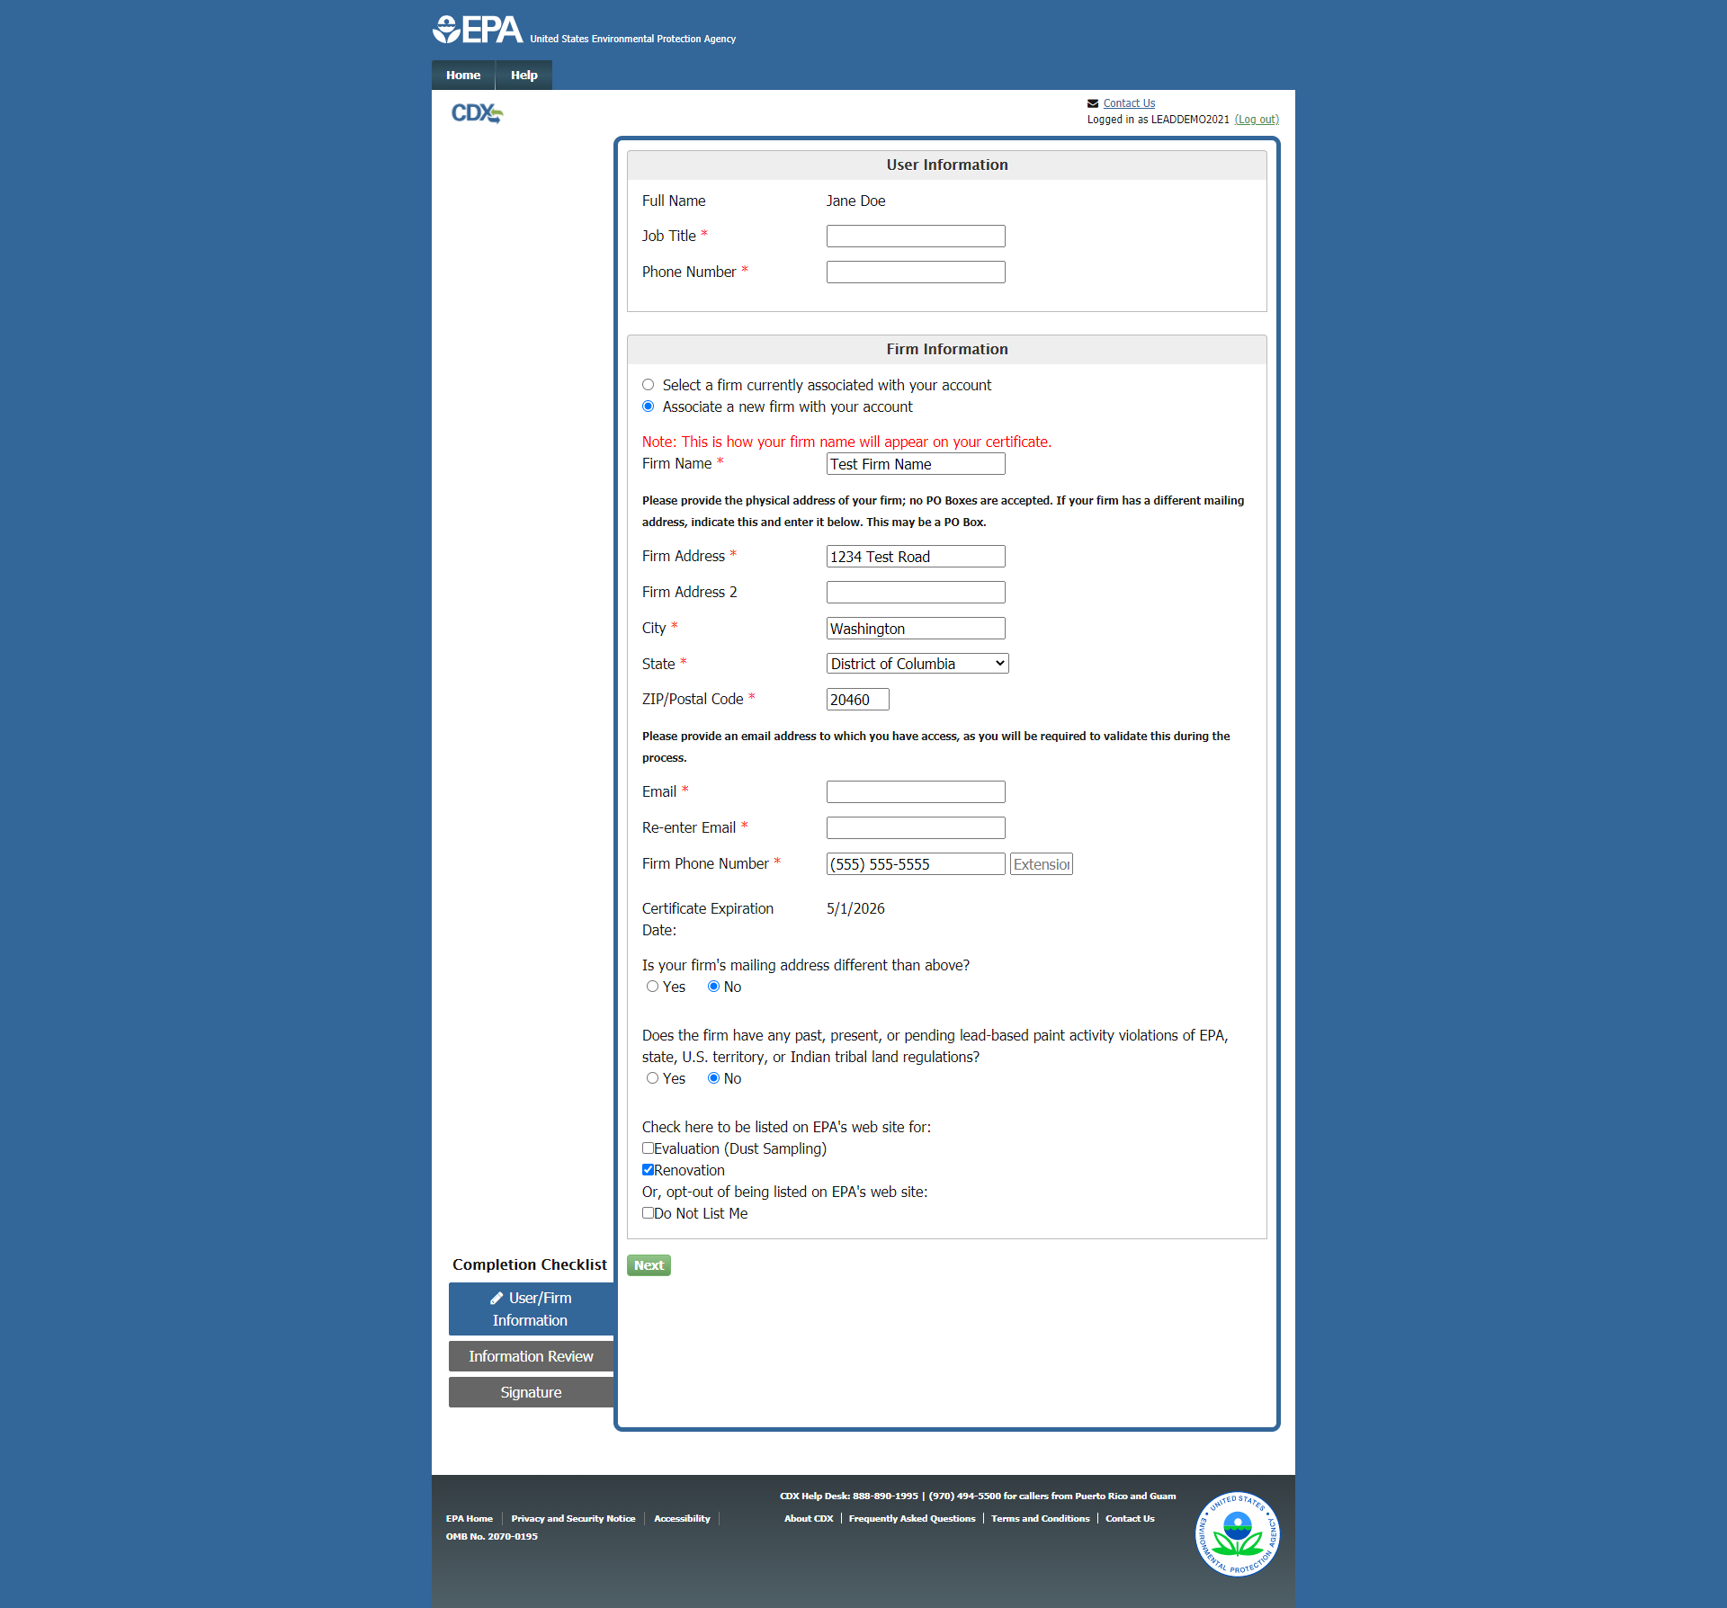
Information-Only Amendment – User/Firm Information Page
Notes:
After logging in, the user is taken to the User/Firm Information page. On this page, the user can make any edits to their firm’s information.

Slide 39
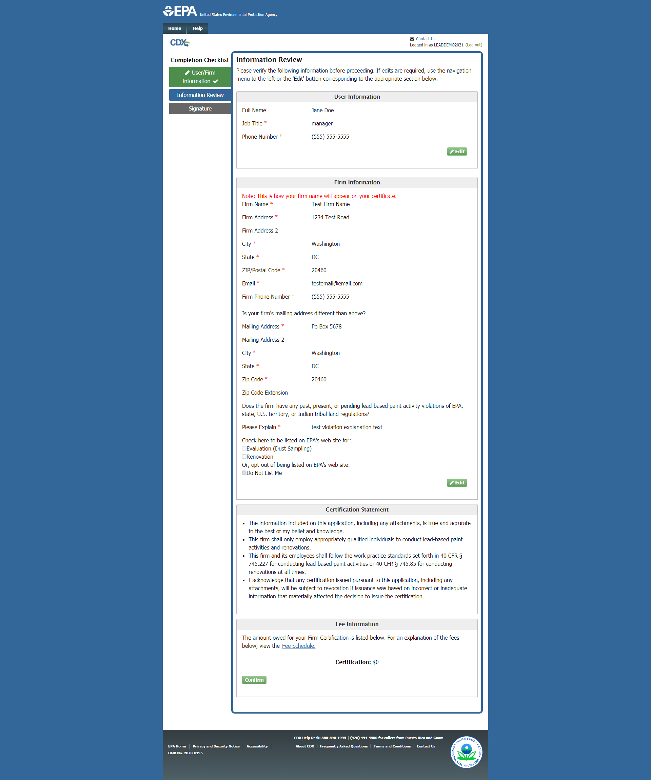
Information-Only Amendment – Information Review Page
Notes:
Any information edited by the user in the previous page is displayed in read-only format on the Information Review page. The information on this page should be confirmed for accuracy. If the user needs to make any edits, click the “Edit” button to return to the previous page. If all of the information is correct, click the “Confirm” button.

Slide 40
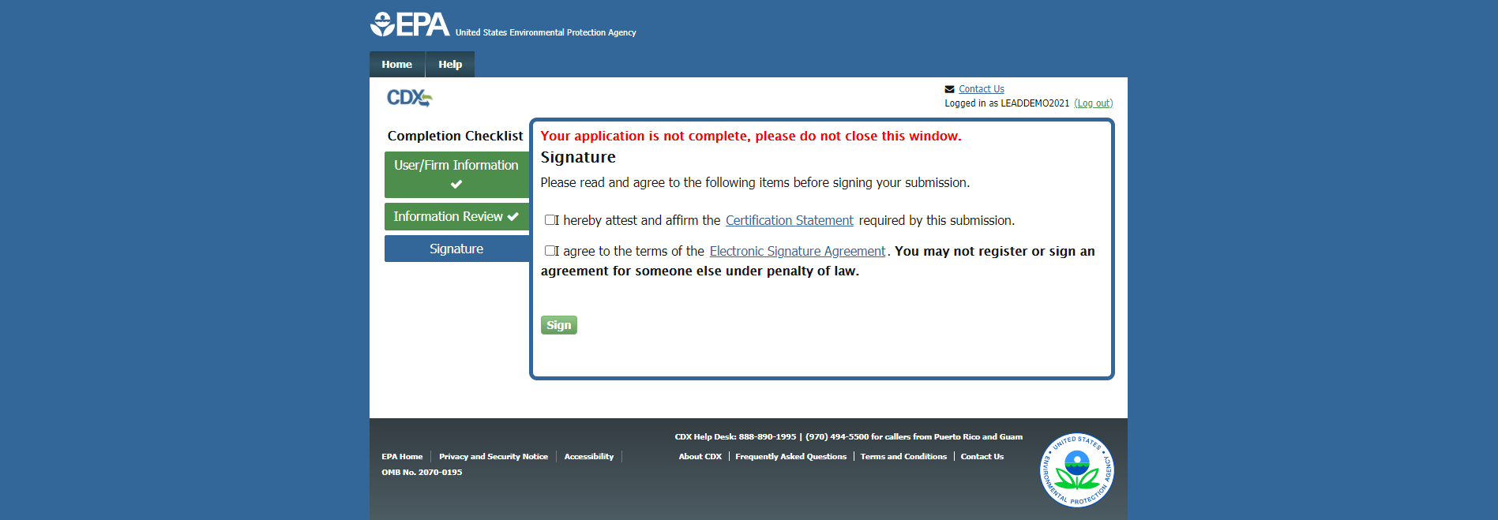
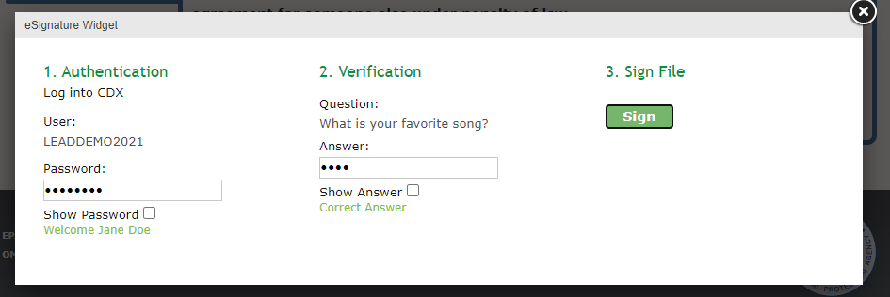
Information-Only Amendment – Signature Page
Notes:
The user is then navigated to the Signature page. Here the user must agree to the terms before signing their submission via the eSignature widget. The user must enter their password and answer a verification question to electronically sign their application.
If signature questions are not already set up, the user may be prompted to select five security questions and answers prior to the eSignature widget displaying.

Slide 41
Information-Only Amendment – Confirmation Page
Notes:
After signing the submission, the user is taken to the confirmation page.

Slide 42
Replace a Certificate – CDX Log In Page
Notes:
Firms seeking to replace their certificate will be navigated to the CDX log in page.
If the user has previously used CDX, they can enter their CDX user ID and password and click the “Log In to CDX” button. If the user has a CDX account but forgot their User ID or password, they can click the appropriate links and follow the steps provided to recover their information. If the user is new to CDX, they can click the “Register” button to create a new account.

Slide 43
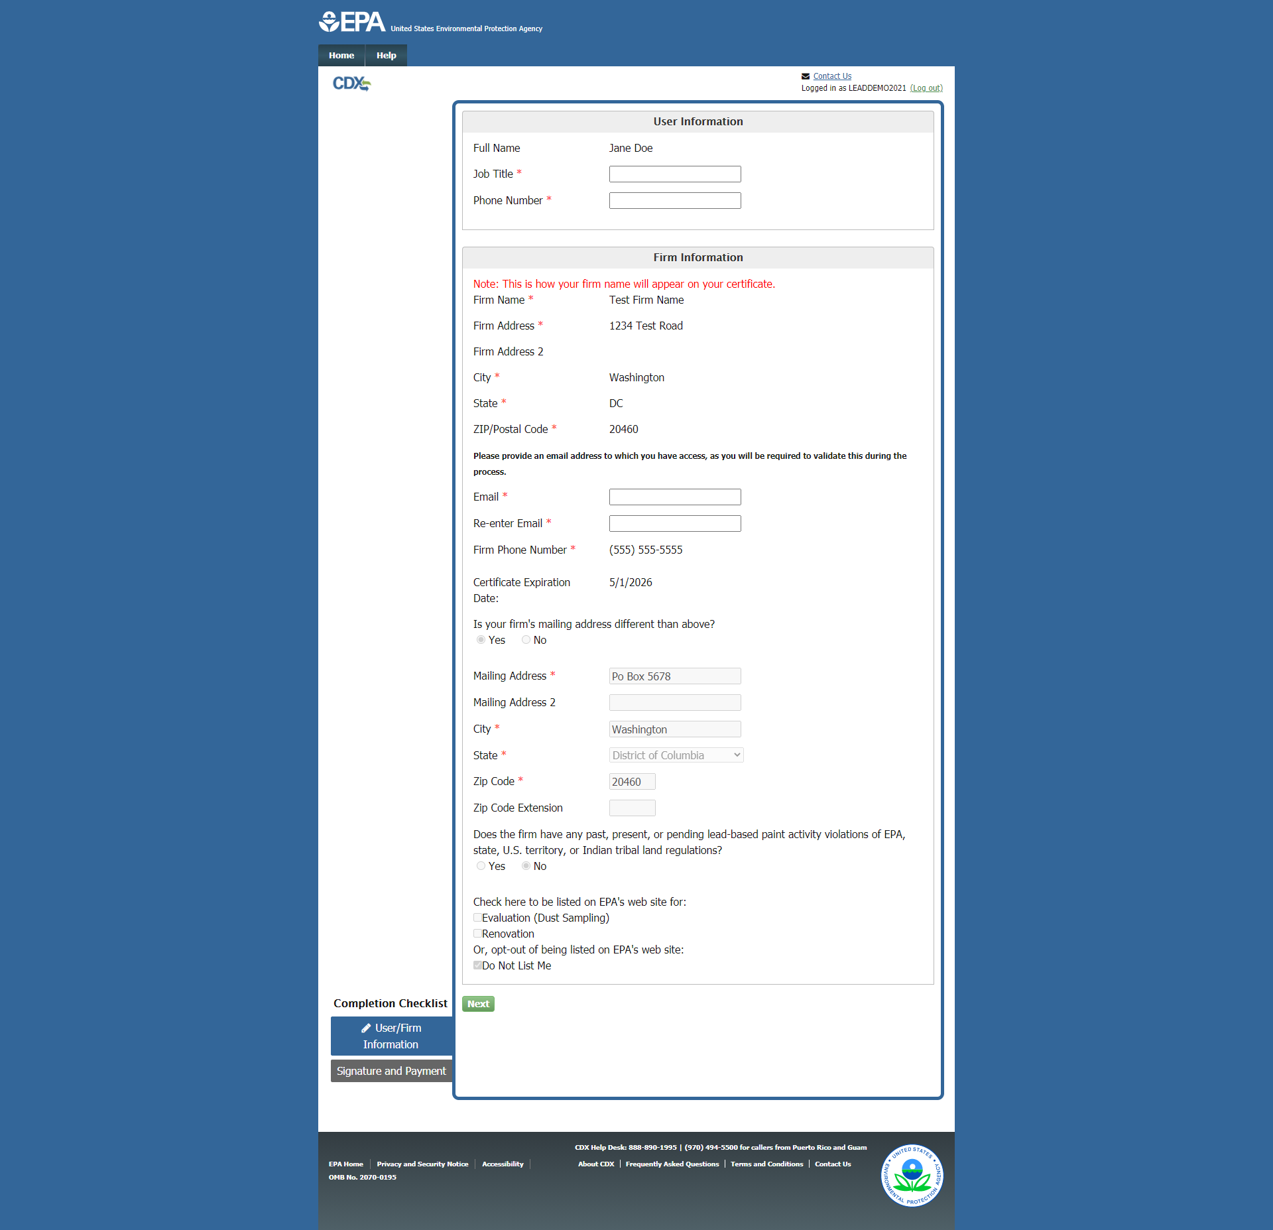
Replace a Certificate – User/Firm Information Page
Notes:
After signing in, the user is navigated to the user information page. The user is not able to edit their firm’s information on this page, this would need to be done separately through the “Update firm certification” option (i.e., as an information-only amendment). The user can only edit their contact information (phone number and email).
Upon clicking “Next,” the user is navigated to the Review and Payment page.

Slide 44
Replace a Certificate – Review and Payment Page
Notes:
The review and payment page will display the firm’s information and allow the user to pay for their certificate replacement request.
Payment can be made via Credit Card, ACH (Bank Routing/Account #), or Payment Code.

Slide 45
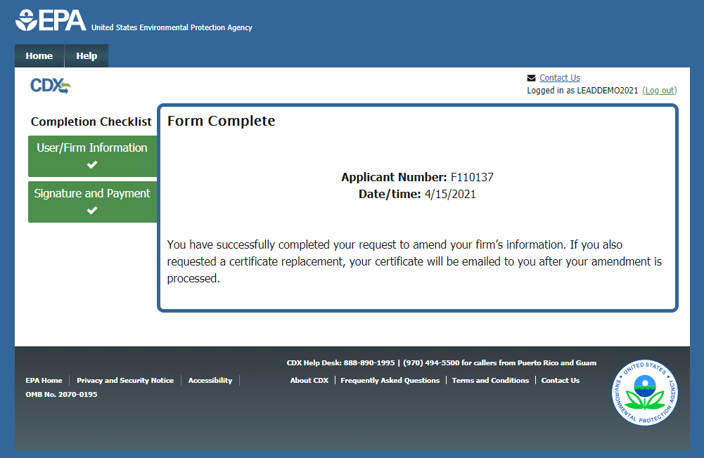
Replace a Certificate – Confirmation Page
Notes:
After signing the submission, the user is directed to the confirmation page.

Slide 46
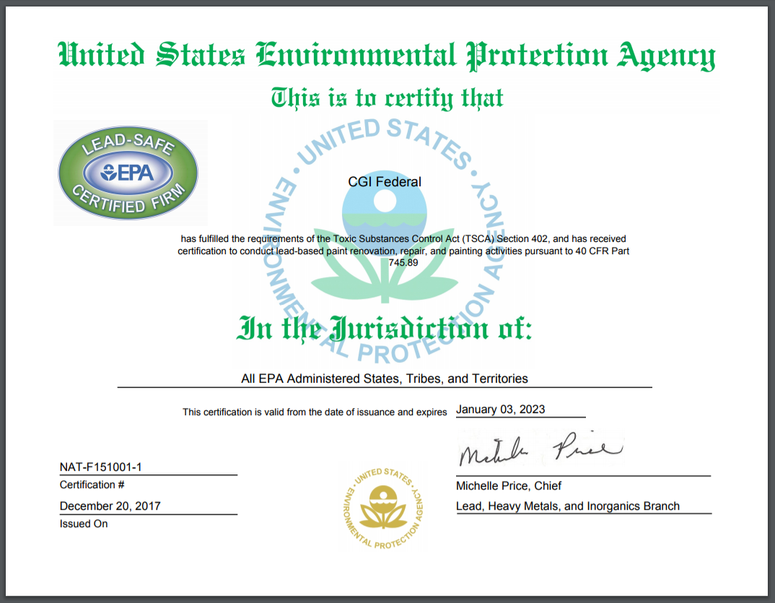
Approval Package – Firm Certificate and Logo
Notes:
Once the application is approved, the certificate and logo will be sent as part of the approval package from EPA. This will be delivered electronically to both the applicant’s email and CDX Inbox for download. If the certificate is ever misplaced or lost, the firm can request a replacement certificate for $15.

Slide 47
Helpful Tips
Remember CDX credentials (user ID & password)
Do not close the browser window until application processing is complete.
Add/whitelist lead.paint@epa.gov to registered email to ensure communications are received in a timely manner.
In addition to being emailed, the approval package will also be posted to the applicant’s CDX Inbox for download.
Notes:
To recap, here are a few helpful tips for successfully completing a Lead firm application.
Firstly, newly registered users should be sure to keep track of their CDX user ID and password, as it will be needed at the end of the application process for submission.
Secondly, the user should avoid closing or refreshing the browser window when the application is processing. It may take a few minutes to process, but they should not close the window until the system indicates that it is safe to do so.
Lastly, certain email systems may label communications from the Lead program as spam. To avoid this, the user should add or whitelist lead.paint@epa.gov in the email account associated to their firm application. Once the application is approved, a copy of the certificate will be delivered to the email and posted to their CDX Inbox.
This concludes the CDX Lead Firm Certification Application tutorial.

