Slide 1
STARS RMAM User Guide for Managing STARS
May 6th, 2022

Slide 2
Overview
This presentation will provide an overview of a few of the functions you, a Registration Maintenance Account Manager (RMAM), can carry out in CDX as an administrator of the STARS application. This guide will show you how to:
Access the RMAM page
Give an existing CDX user access to the EPA reviewer roles
Create a CDX account with an EPA reviewer role for a new user
Approve an Applicant’s request to access STARS
Request that an existing CDX user receives RMAM privileges
The EPA reviewer roles allows a user to:
View Submitted Tire Applications
Download .csv export of submitted application data

Slide 3
Access the RMAM page

Slide 4
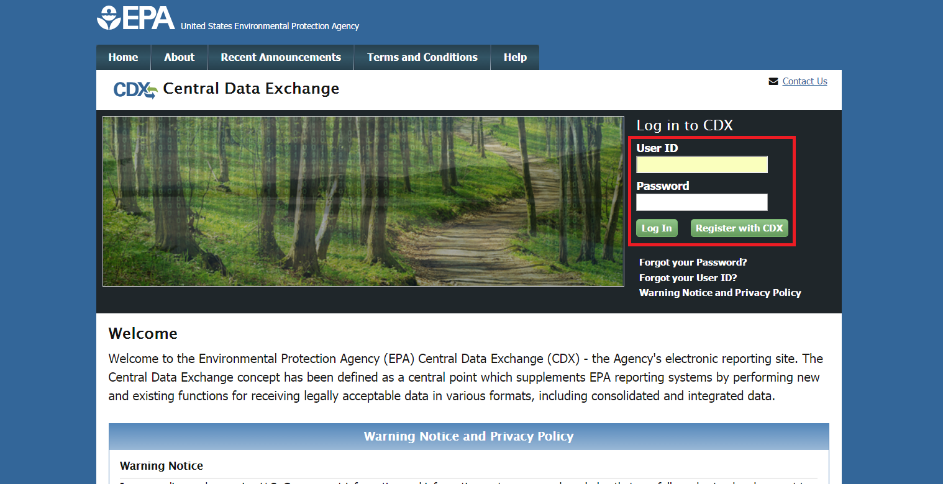
RMAM Page: CDX Home with Log In
To begin, access the CDX homepage (https://cdx.epa.gov/) and log in with your User ID and password.

Slide 5
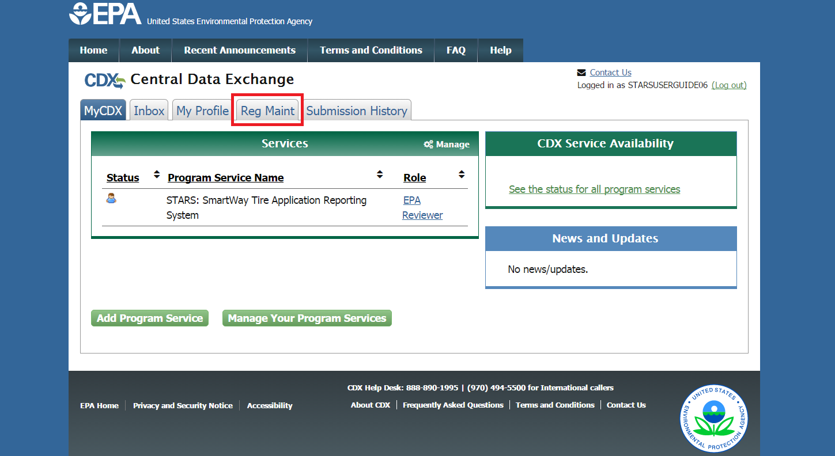
RMAM Page: MyCDX with Reg Maint Tab
After logging in, select the Reg Maint tab.

Slide 6
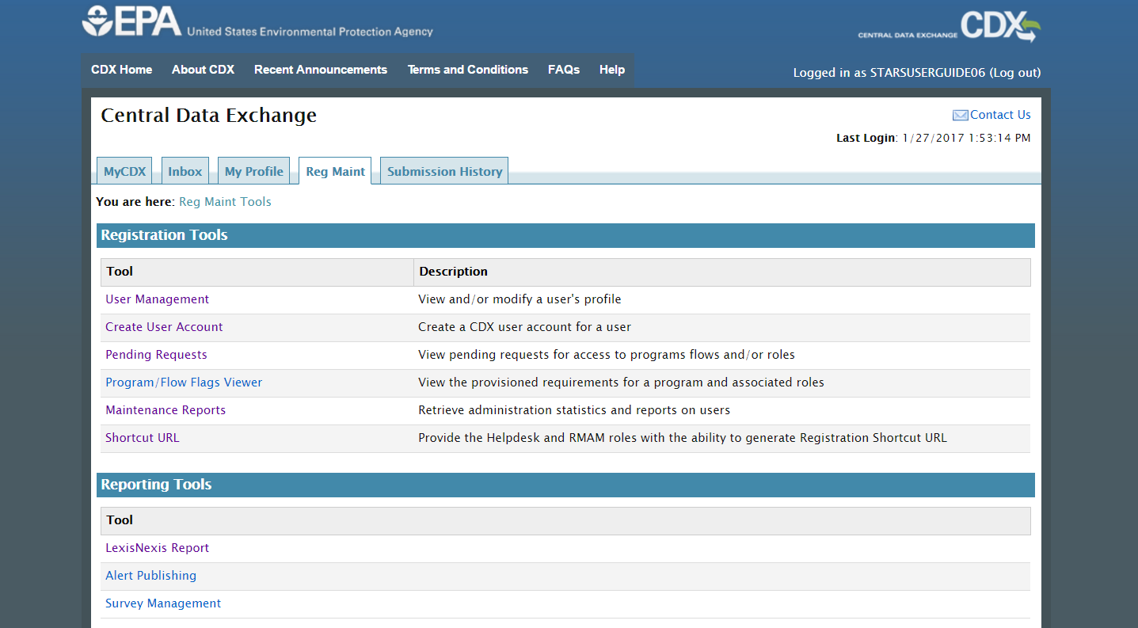
RMAM Page: Reg Maint Tab
From the Reg Maint tab, you will have access to multiple Registration Maintenance tools.

Slide 7
Give an existing CDX user access to the EPA reviewer roles

Slide 8
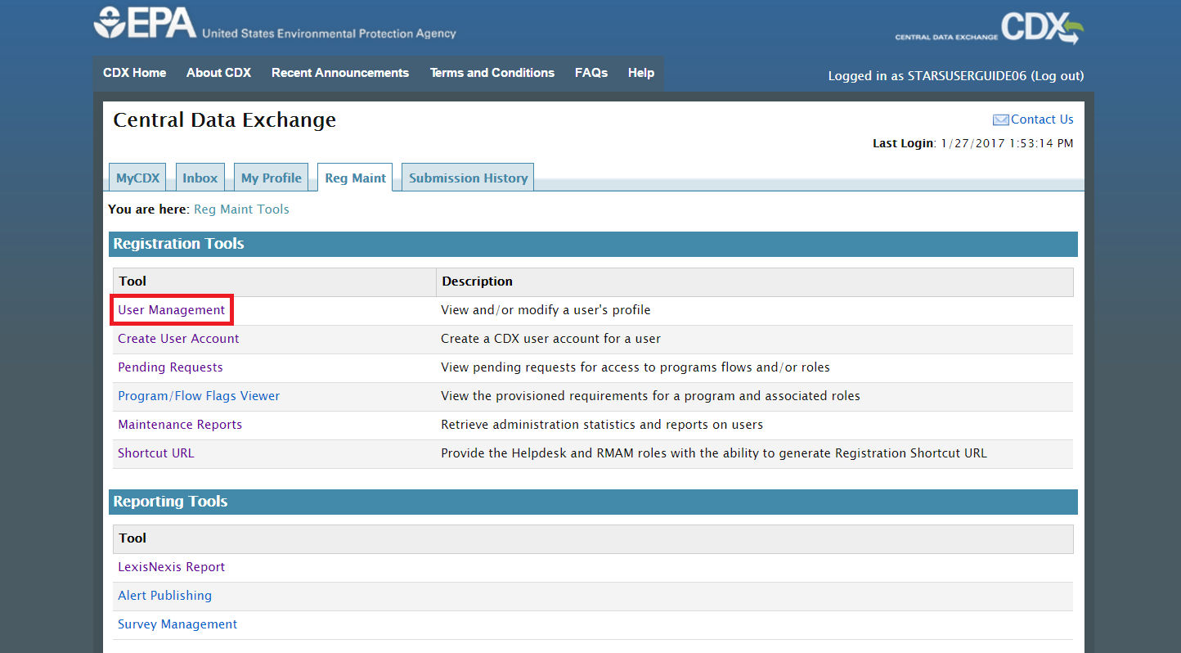
RMAM Page: Reg Maint with User Management Link
To edit an existing user’s account, from the Reg Maint tab, select User Management.

Slide 9
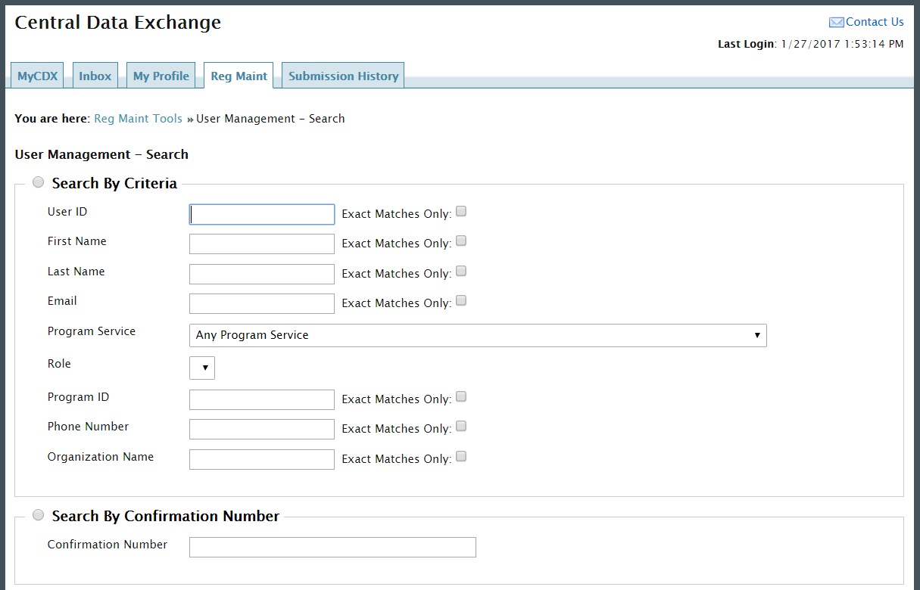
RMAM Page: User Management - Search
You will be brought to the Search page where you can search for users by various criteria. You can search for users across all Program Services, regardless of the Program Service you have access to.

Slide 10
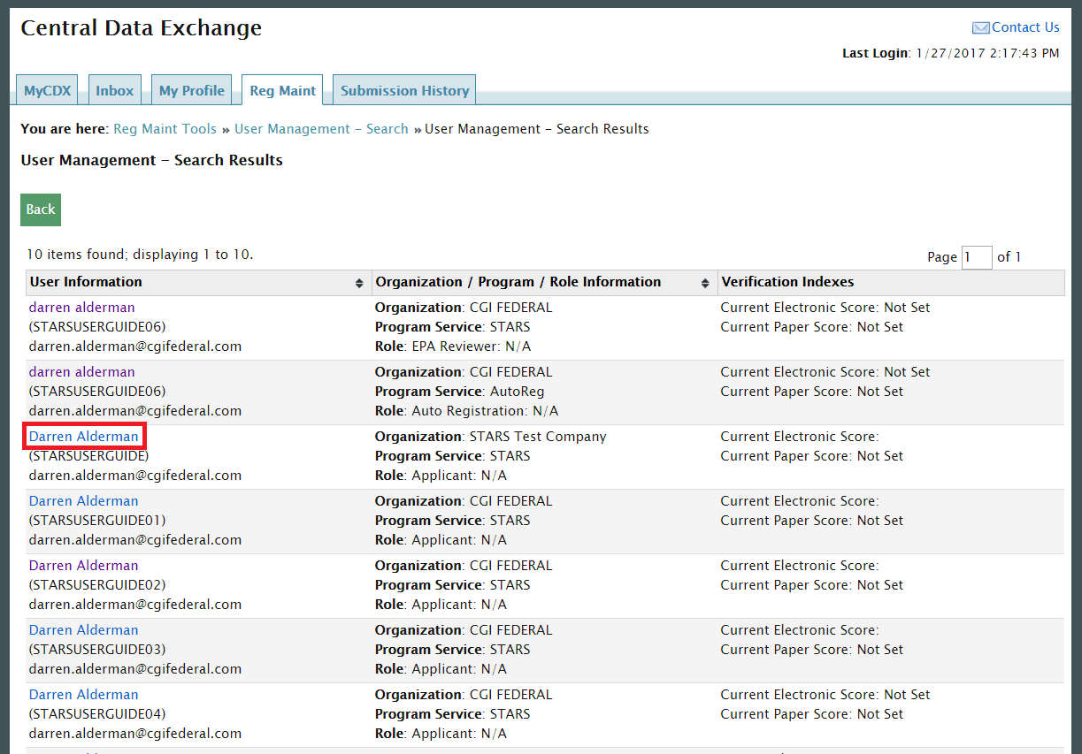
RMAM Page: User Management – Search Results
Search results are displayed in a table. If multiple pages of results are returned, you can navigate through the pages. Clicking on a user’s name will open their User Details.

Slide 11
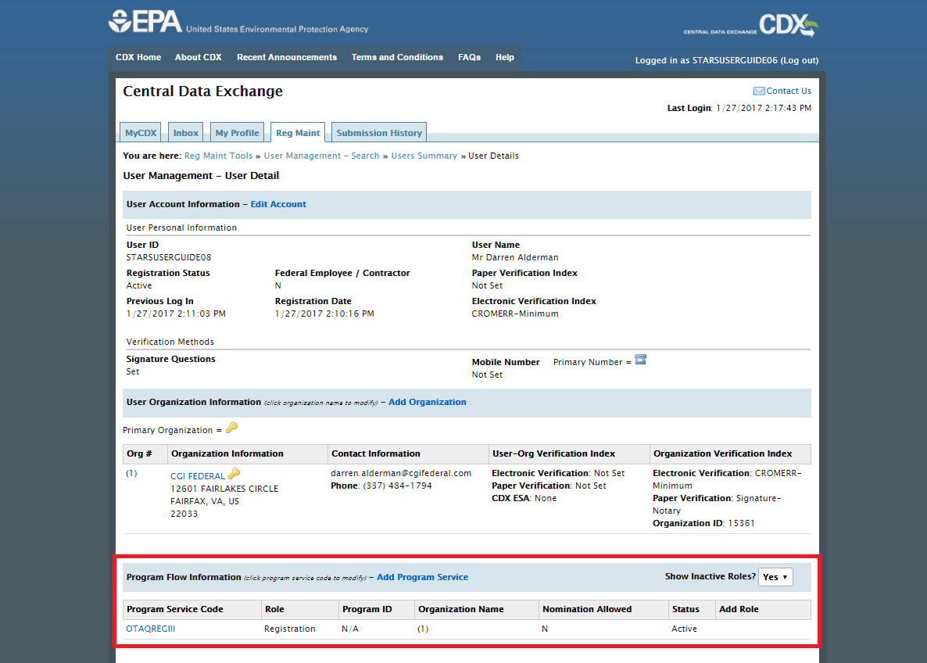
RMAM Page: User Management – User Details
From the User Details page, you can edit a user’s Account, Organization, and Program Flow Information. You can give a user the EPA Reviewer role in the Program Flow Information section.

Slide 12
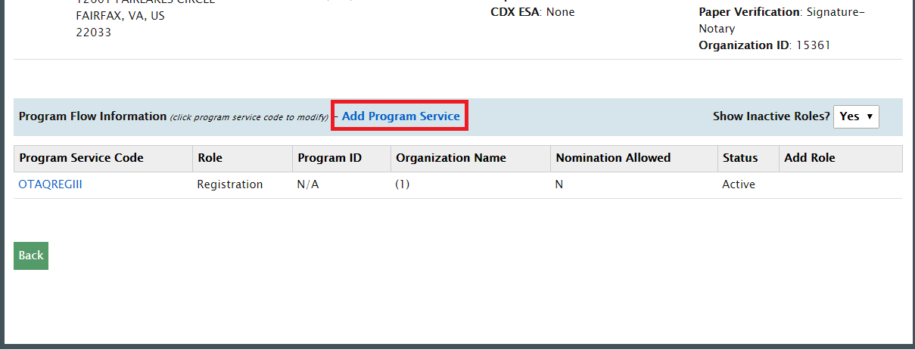
RMAM Page: User Management – User Details – Program Service
If STARS is not listed in the Program Service table, you will need to select Add Program Service to give the user the EPA Reviewer role.

Slide 13
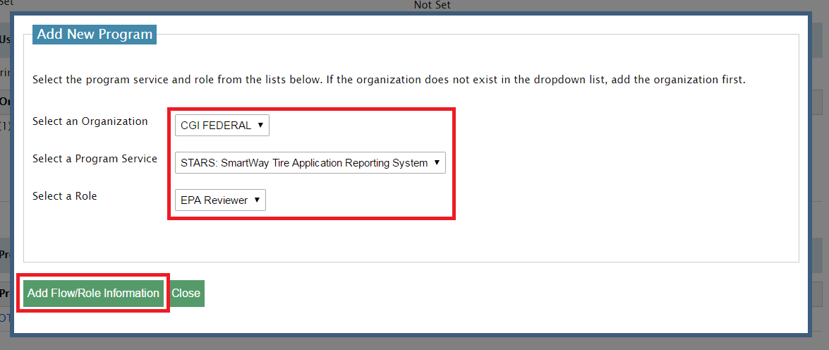
RMAM Page: User Management – User Details – Add New Program
Select the user’s organization. Then, select STARS as the Program Service and EPA Reviewer, Center Director, or Division Director as the Role. Finally, select Add Flow/Role Information and the Approve the new role.

Slide 14
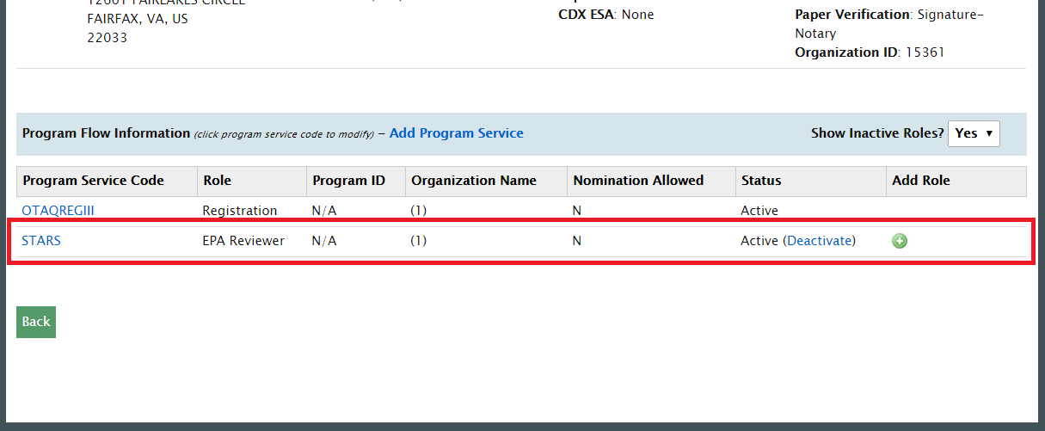
RMAM Page: User Management – User Details – Program Service
The user now has access to the EPA Reviewer role.

Slide 15
RMAM Page: User Management – User Details – Additional Notes
If the user already has access to the STARS Program Service through another role, you can give the user access to the EPA Reviewer, Center Director, or Division Director roles by selecting the Add Role icon.
Additionally, you can Activate or Deactivate a user’s access to STARS by changing the Status.

Slide 16
Create a CDX account with an EPA reviewer role for a new user

Slide 17
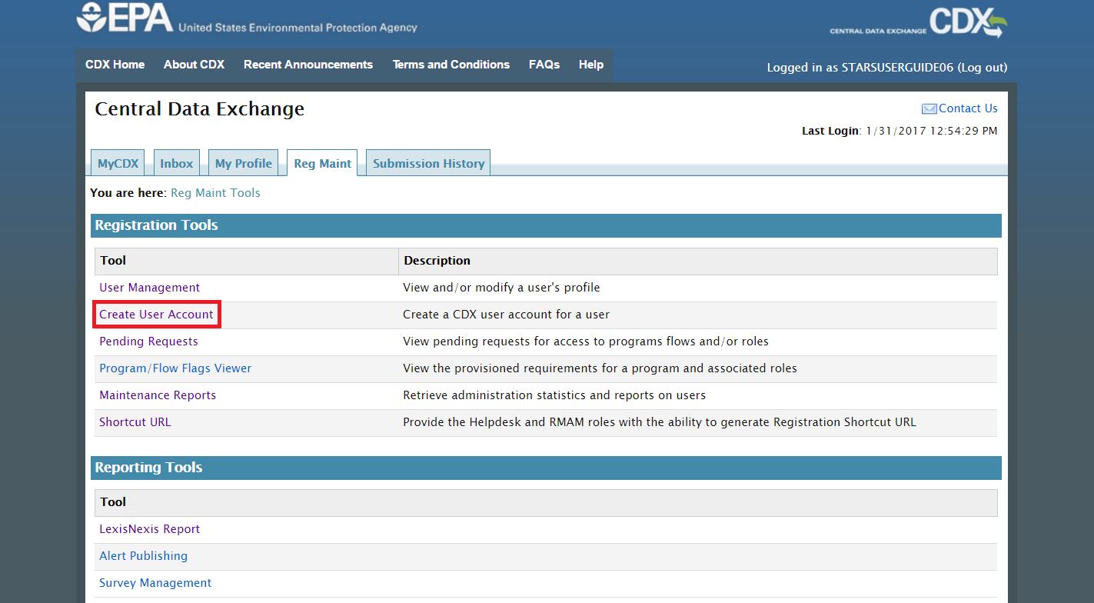
RMAM Page: Reg Maint with Create User Account Link
To create an account for a user, from the Reg Maint tab, select Create User Account.

Slide 18
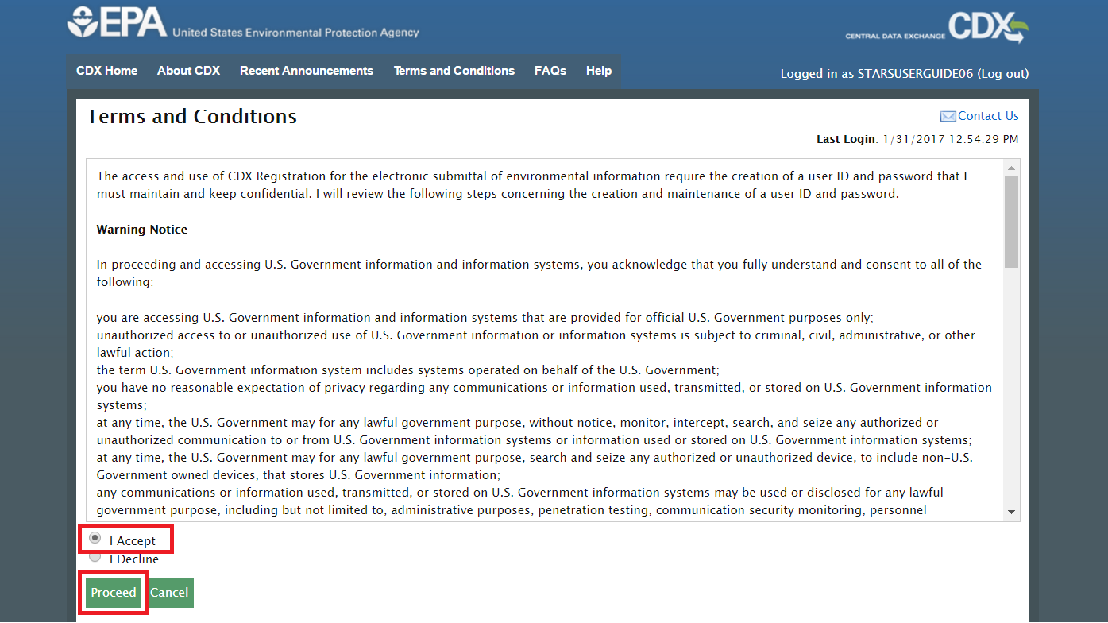
RMAM Page: Terms and Conditions
As the RMAM, you will be required to accept the Terms and Conditions on behalf of the user you are creating the account for.

Slide 19
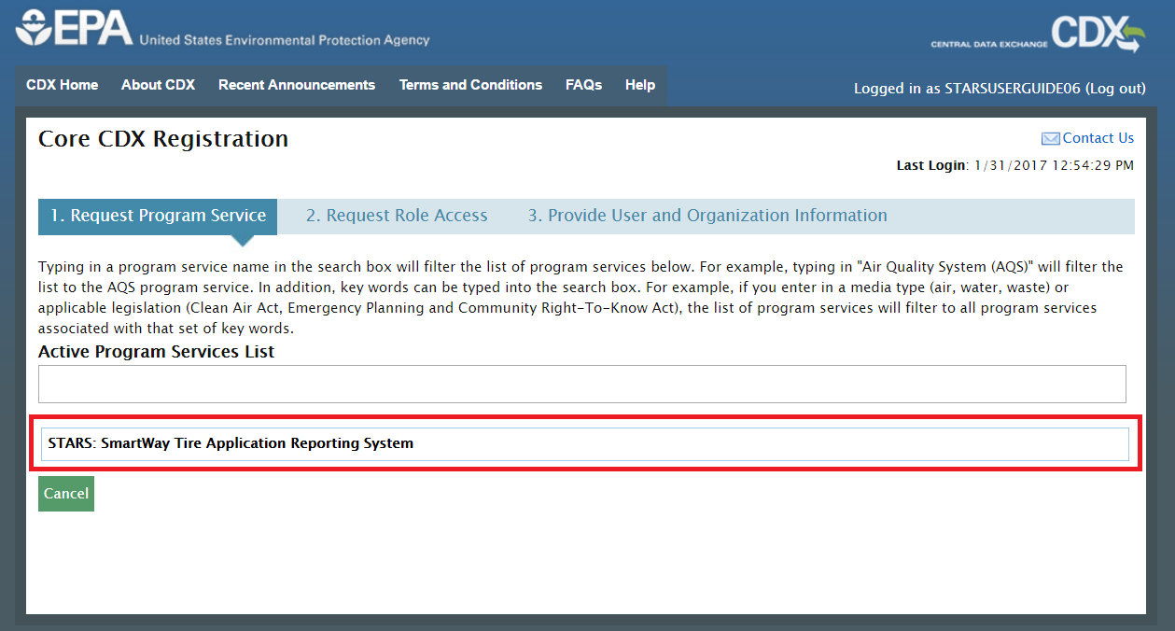
RMAM Page: Request Program Service
Select STARS – the Program Service for which you are registering the user. Your selection will be limited to the Programs you have RMAM privileges for.

Slide 20
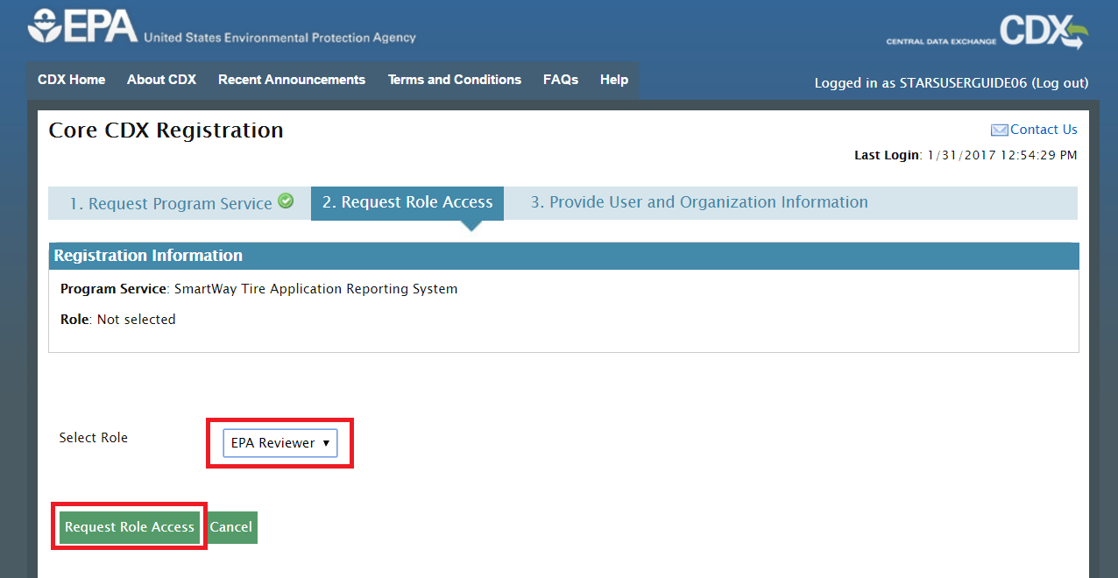
RMAM Page: Request Role Service
Select EPA Reviewer, Center Director, or Division Director – the role for which you are registering the new user.

Slide 21
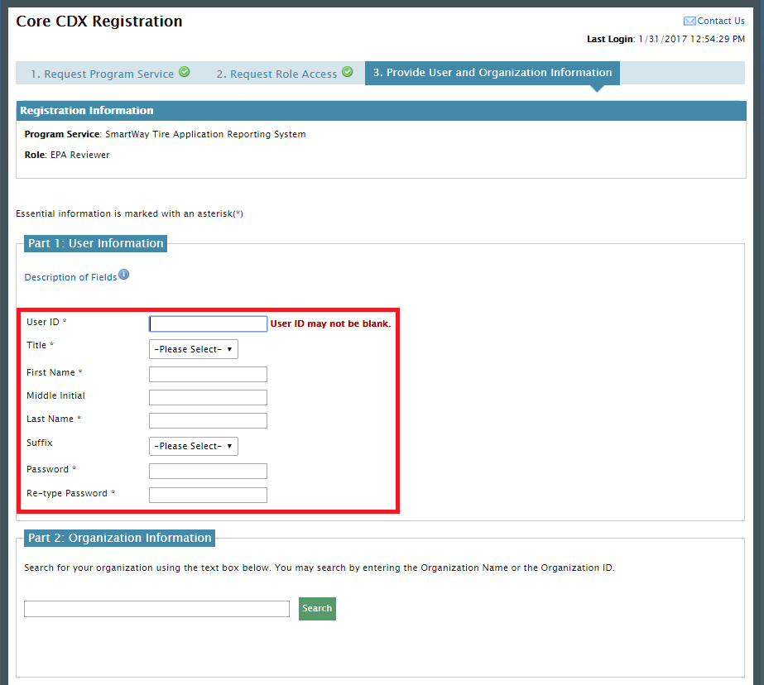
RMAM Page: Provide User and Organization Information
Provide the new user’s information, including the selection of a username and password. The user will update this password once they log in to their new account.
Note: You will need to provide the user with the temporary password you enter.

Slide 22
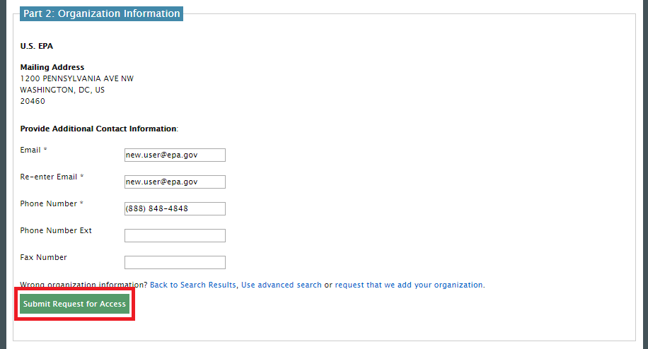
RMAM Page: Provide User and Organization Information
Provide the user’s Organization information on behalf of the user, including an email and phone number. Once the information is filled out, you can submit the request for the new account.

Slide 23
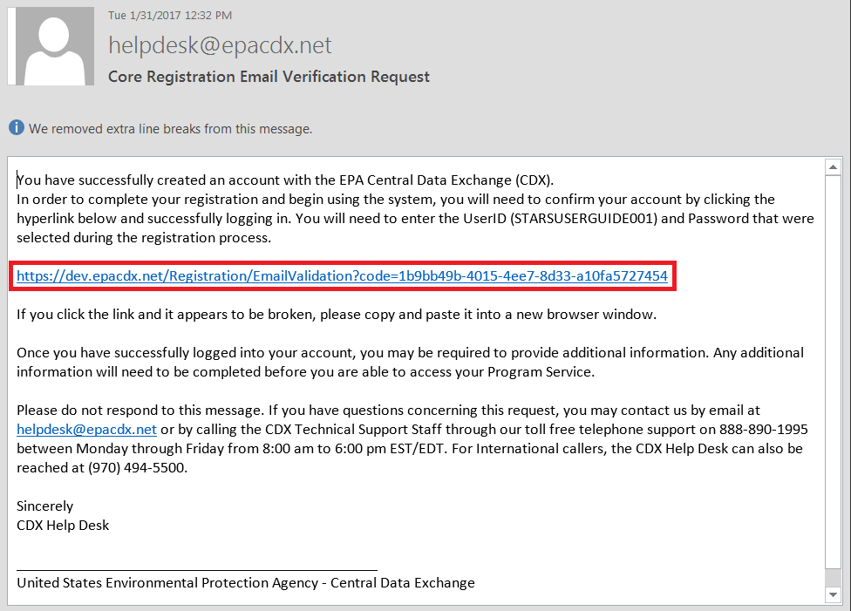
RMAM Page: New CDX User Email
Once you submit the New User request, an email will be sent to the email you provided for the user. The new user will need to follow the link and log into CDX using the username and password you specified for the new user account.
Note: You will need to approve the request in order for the new user to have access to a EPA reviewer role.

Slide 24
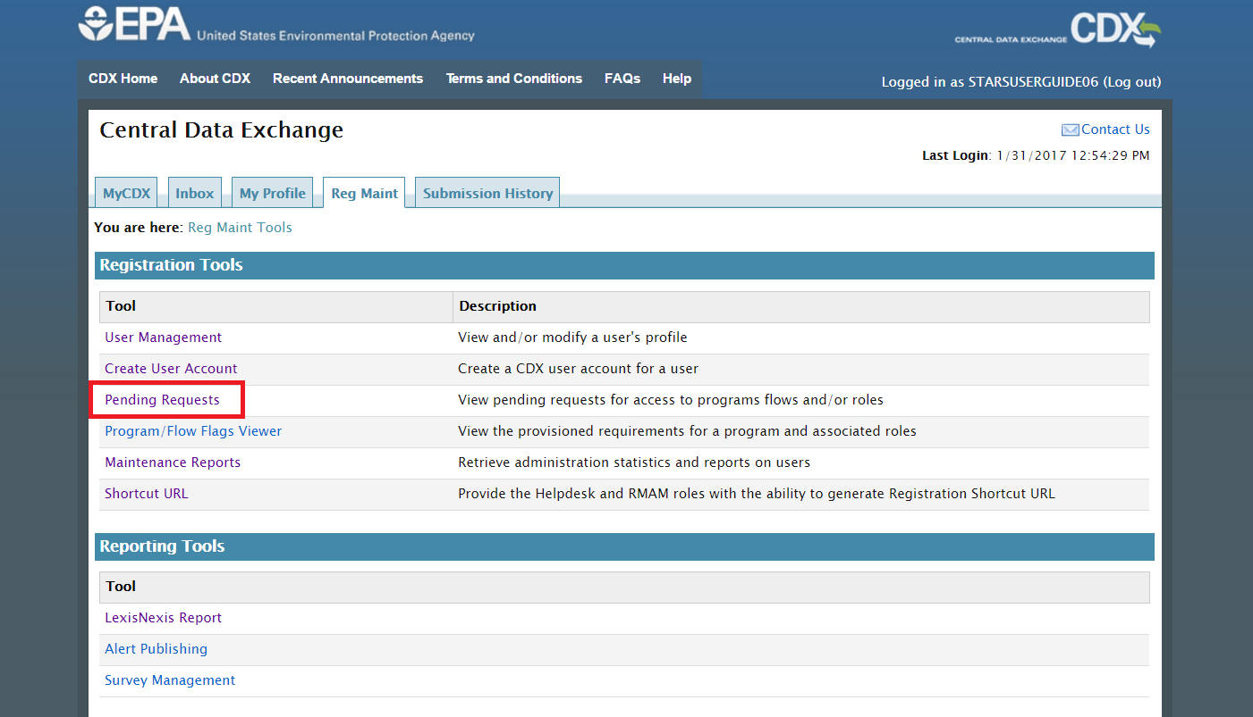
RMAM Page: Reg Maint with Pending Request Link
To approve any pending requests, from the Reg Maint tab, select Pending Requests.

Slide 25
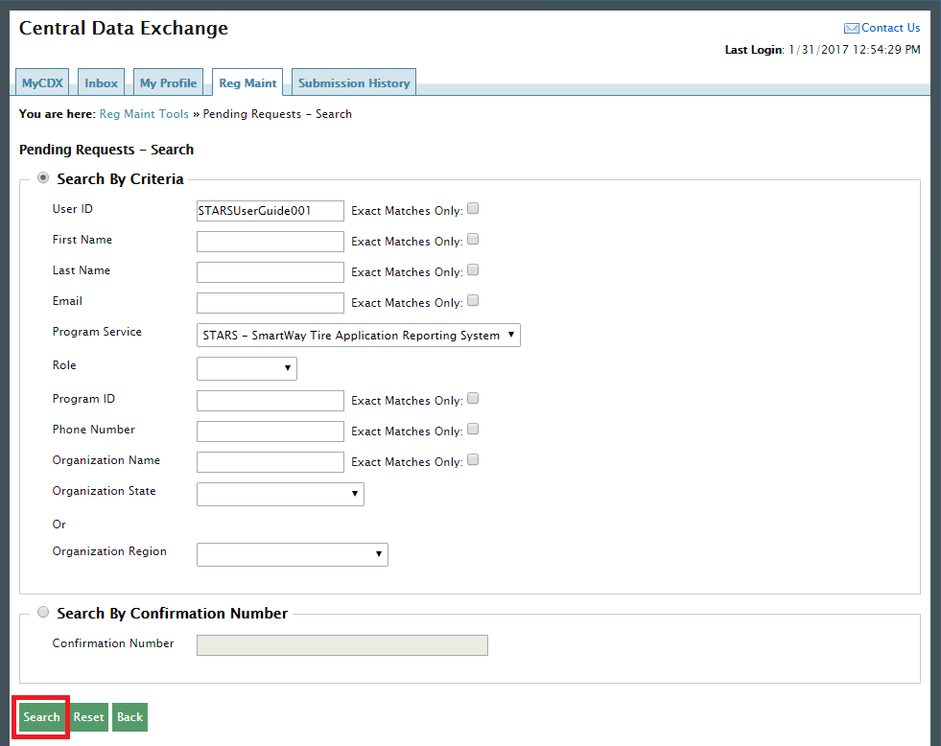
RMAM Page: Pending Request - Search
You will be brought to the Search page where you can search for users by various criteria. You will only be able to search across Program Services you have access to.
Search for the User ID you just created to activate the account.

Slide 26
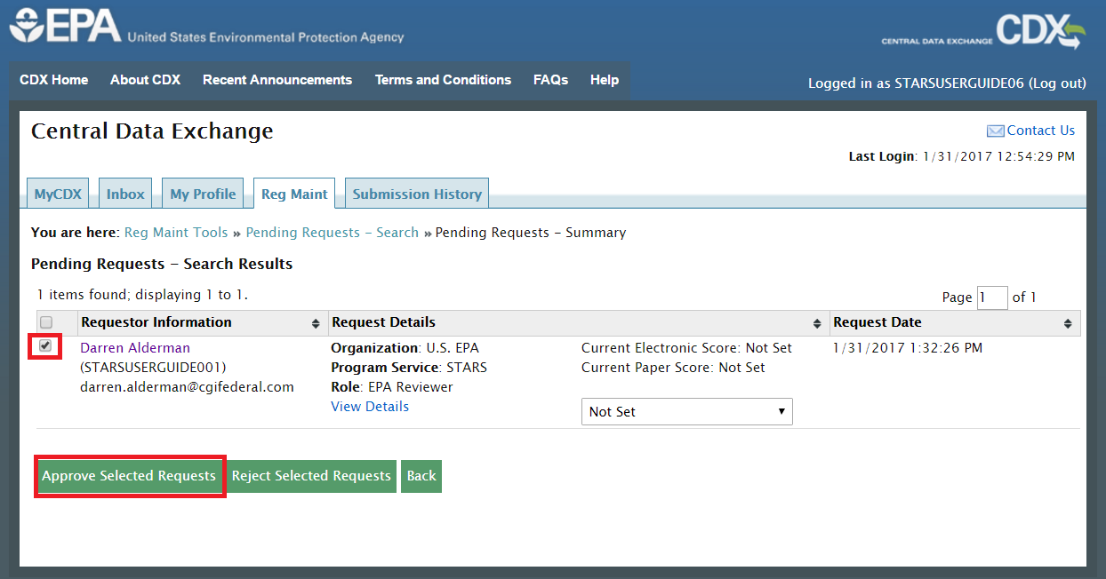
RMAM Page: Pending Request - Search Results
Results from your search are displayed in the table. Select the checkboxes associated with the requests you wish to approve. Select Approve Selected Requests.

Slide 27
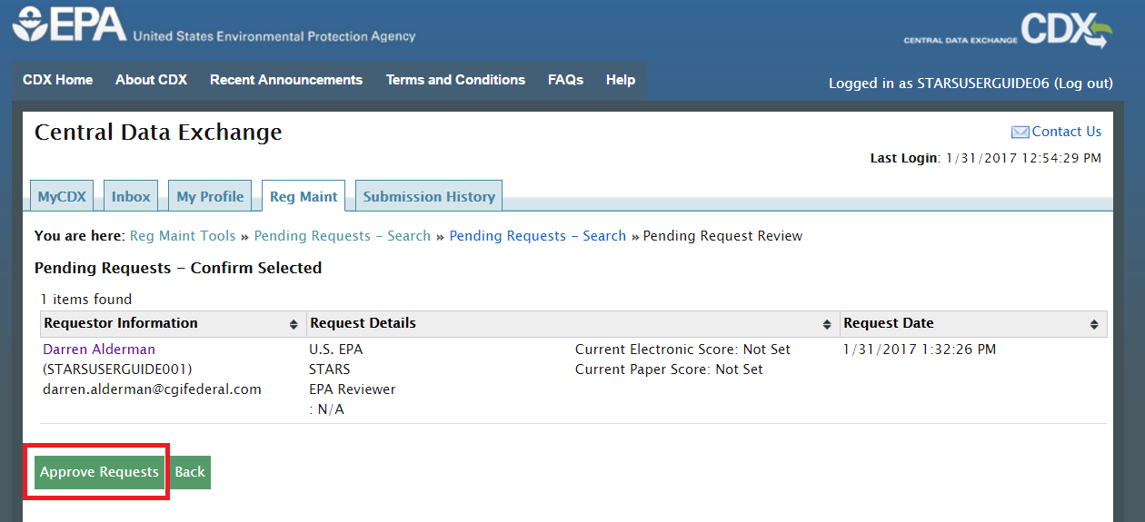
RMAM Page: Approve Pending Requests
Review the requests you selected and select Approve Requests. The new user you created will now have access to STARS.

Slide 28
Approve an Applicant’s request to access STARS

Slide 29
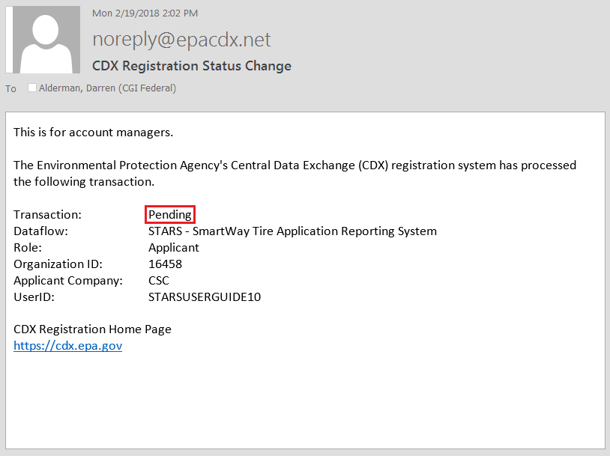
RMAM Page: Applicant Role Request Notification
When a new Applicant requests access to the STARS application, you will receive a notification email similar to the one below. You will need to approve this user’s request before they can submit applications in the STARS application.

Slide 30
RMAM Page: Reg Maint with Pending Request Link
To approve any pending requests, from the Reg Maint tab, select Pending Requests.

Slide 31
RMAM Page: Pending Request - Search
You will be brought to the Search page where you can search the pending requests by searching for the User ID in the notification email. Alternatively, you could search for the STARS Program Service to see all Pending Requests for the STARS program.

Slide 32
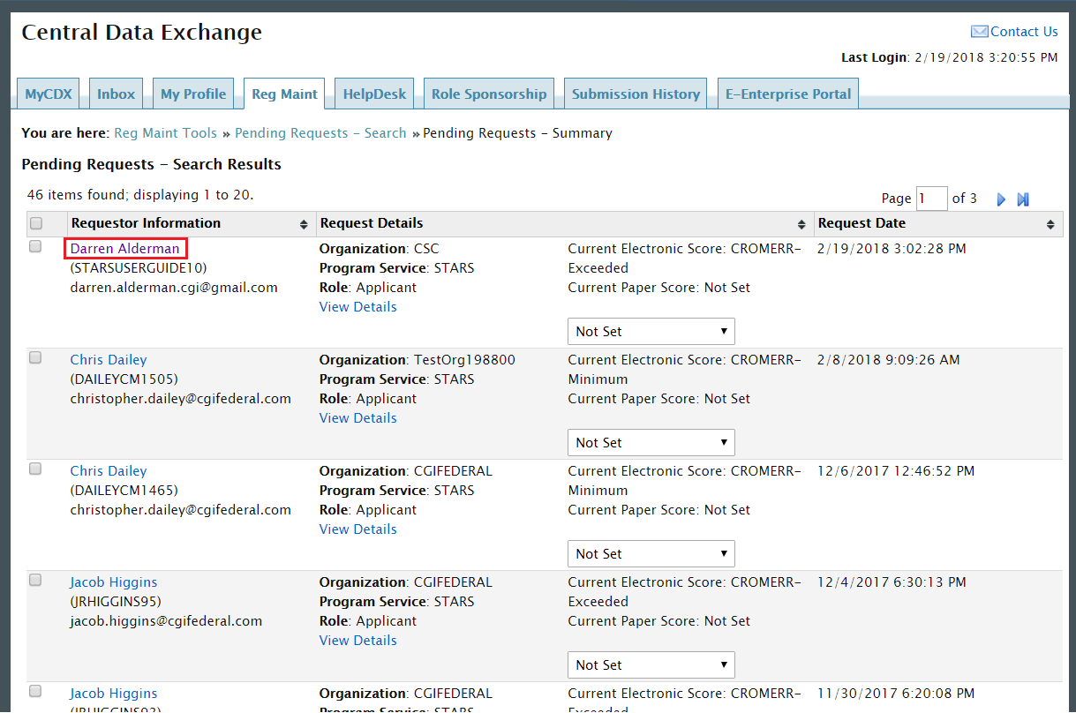
RMAM Page: Pending Request - Search Results
Locate and select the hyperlinked name above the CDX User ID that was listed in the pending request notification.

Slide 33
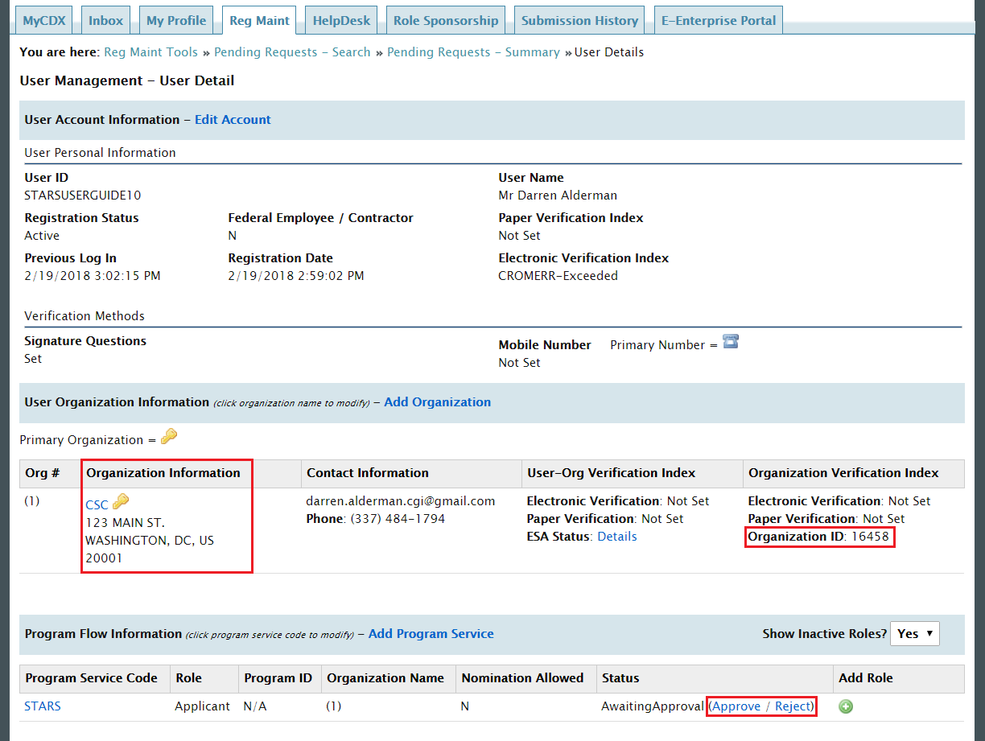
RMAM Page: Approve Role Access on User Details
Note: User’s with the same Organization ID can see each other’s applications. If multiple user’s would like to submit applications for the same organization, they will all need to be registered under the same Organization ID to see and share applications.
Once you have verified the user’s organization, select ‘Approve’ to activate the user’s account.

Slide 34
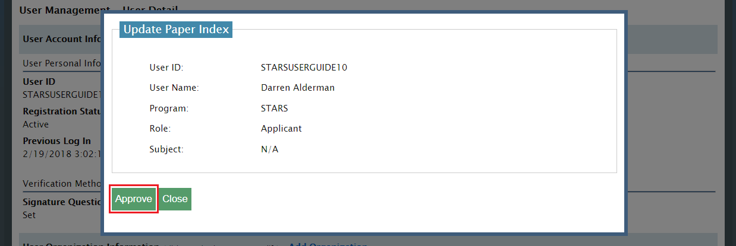
RMAM Page: Verification of Approval
You will be asked to confirm you would like to approve the request, select ‘Approve.’

Slide 35
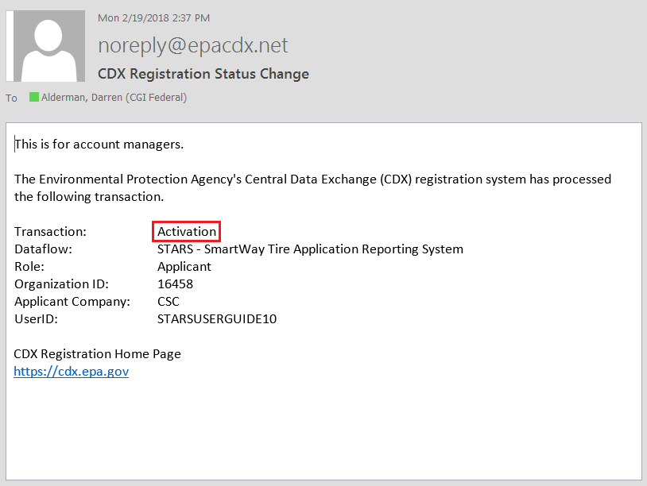
RMAM Page: Activation Notification
You will receive a confirmation notification similar to the one below indicating the user’s account has been activated. The Applicant will also receive a system-generated notification.

Slide 36
Request that an existing CDX user receives RMAM privileges

Slide 37
Request RMAM Privileges
If you would like give another CDX user RMAM privileges or you have any other questions please contact:
Kyle Speight– CGI
kyle.speight@cgifederal.com
919-802-6475

